Slide 1

T cells and cell mediated immune responses
Farshid Yeganeh, PhD
Immunology Dept.
Shahid Beheshti University of Medical Sciences

Slide 2
Learning Objectives
By the end of this session, students will be able to:
  Differentiate between T cell types (CD4+ and CD8+).
  Describe the process of T cell activation and differentiation.
  Explain the role of T cells in cellular immunity.
  Identify the pharmacological interventions targeting T cell responses.
  Relate the role of T cells in autoimmune diseases, infections, and cancer.

Slide 3
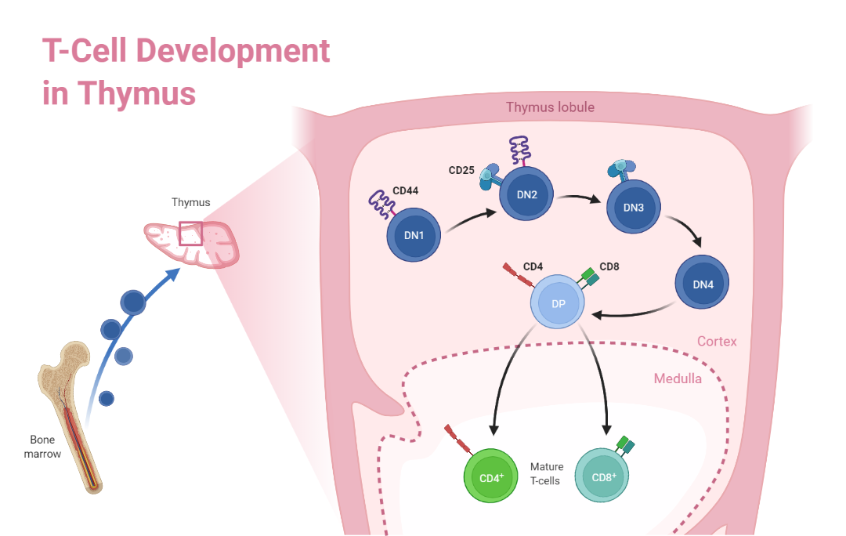
Role of the thymus in T cell maturation

Slide 4
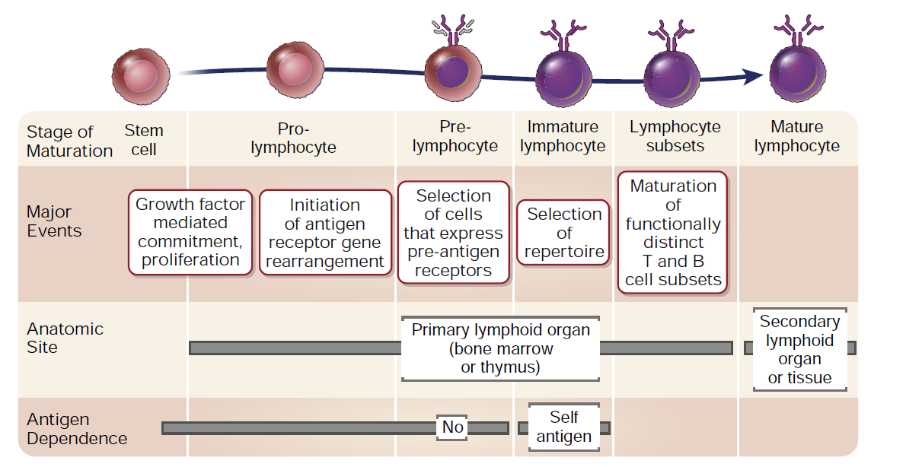
Stages of lymphocyte maturation

Slide 5
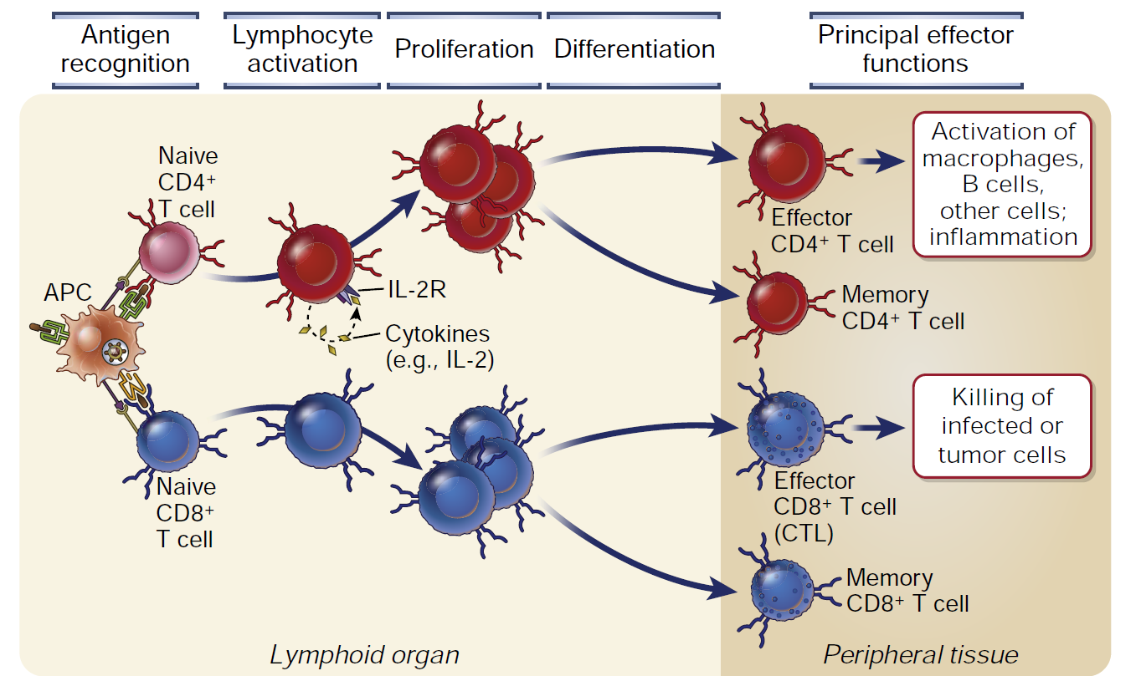
Sequence of events in T cell responses

Slide 6
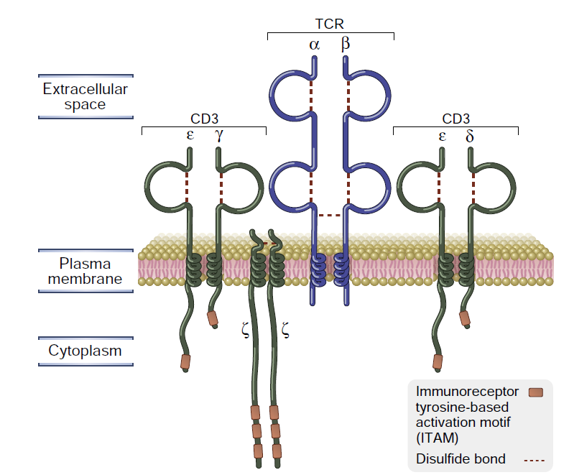
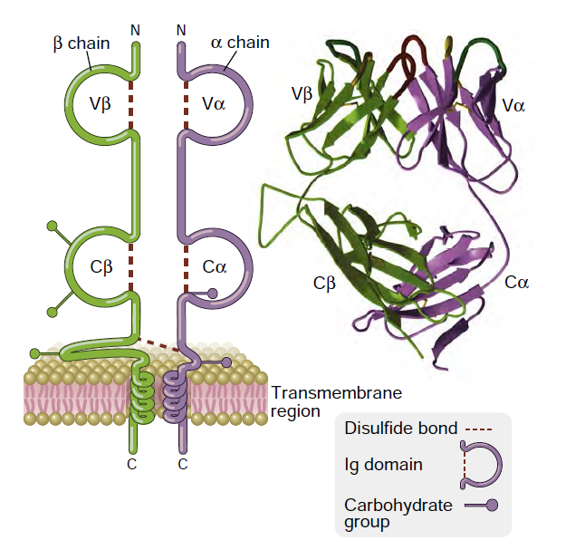
Structure of the T cell receptor

Slide 7
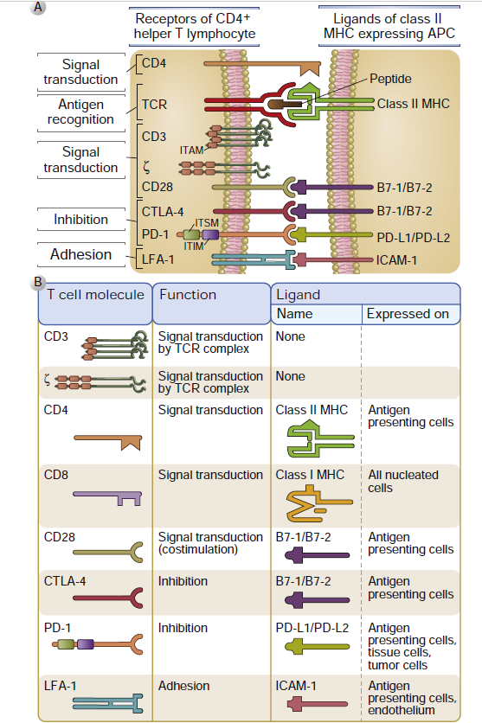
Activation of T Cells
2 signals model

Slide 8
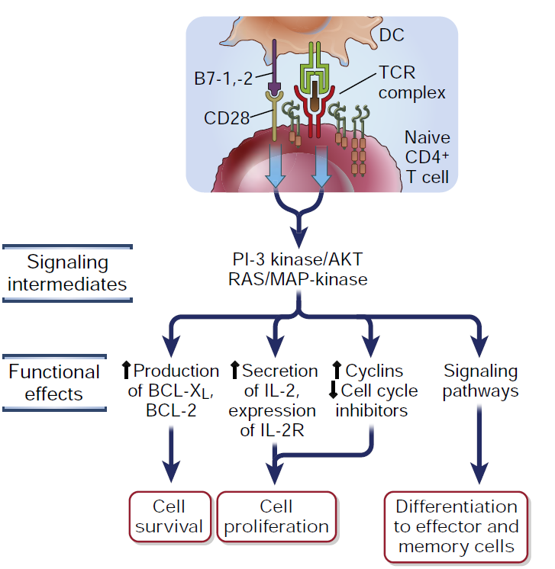
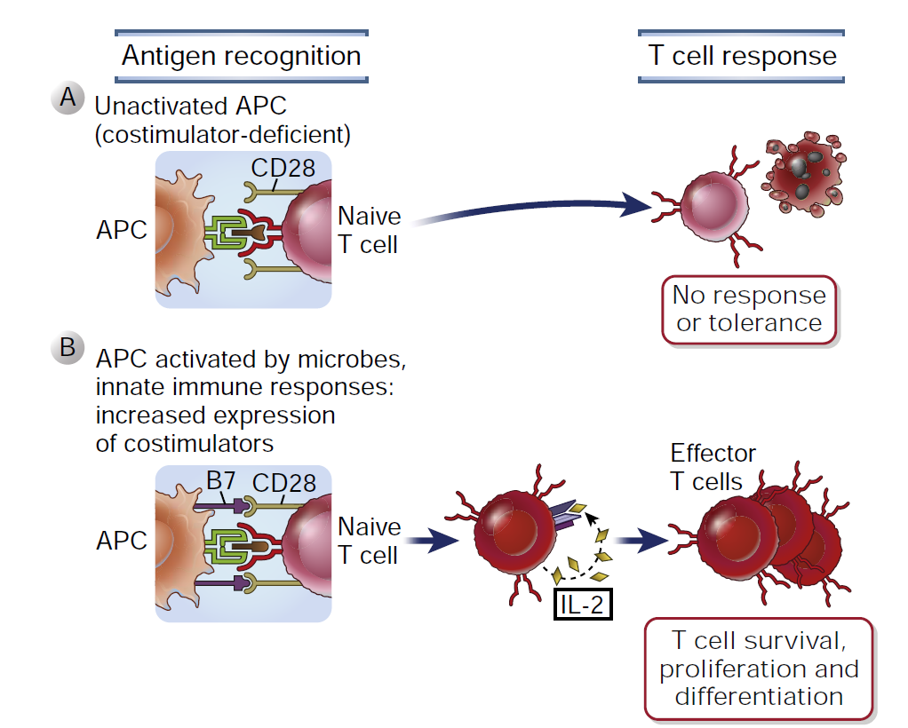
Recognition of Antigen and costimulatory molecules

Slide 9
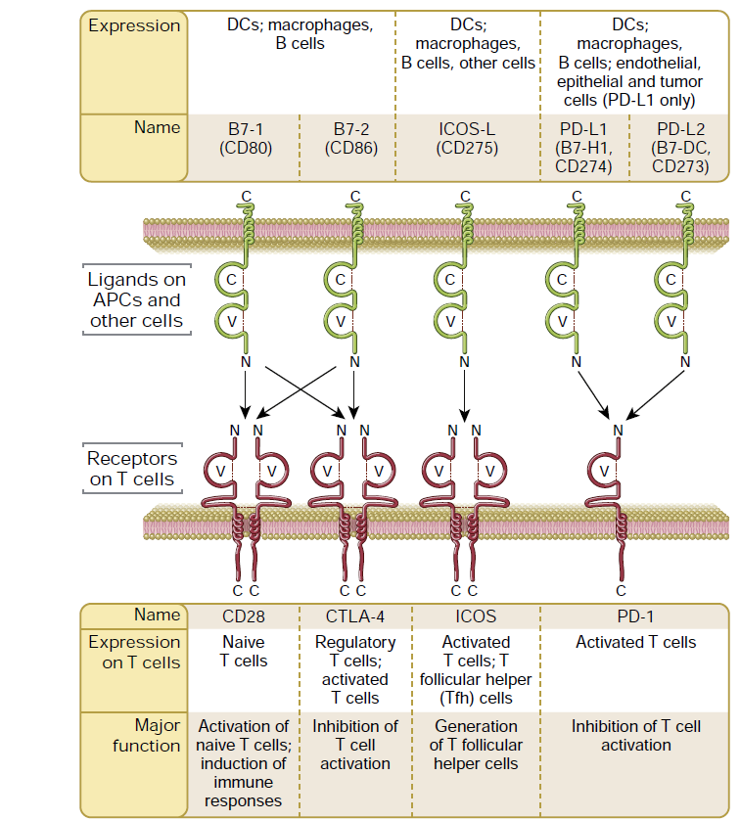
The major members of the B7 and CD28 families

Slide 10
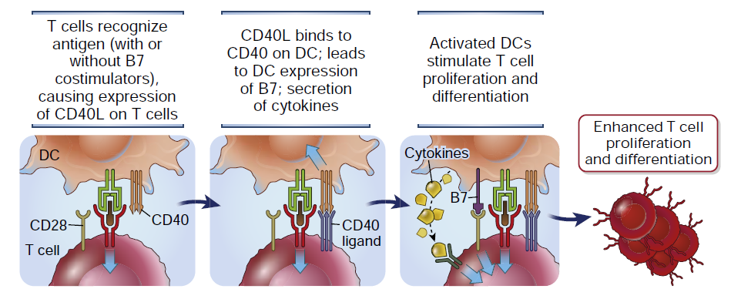
Other Costimulatory Pathways: Role of CD40 in T cell activation

Slide 11
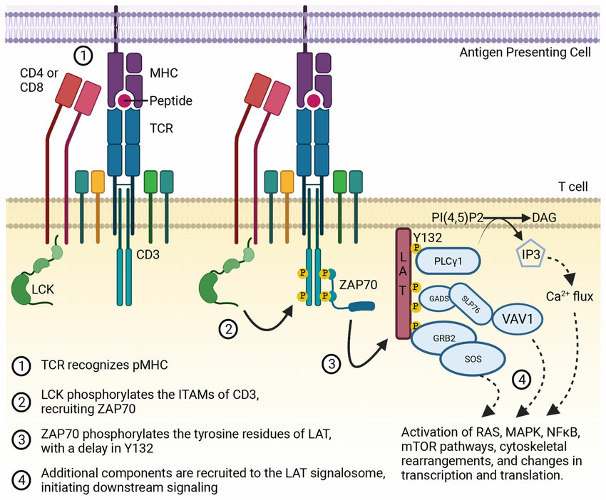
Activation of T Cells

Slide 12
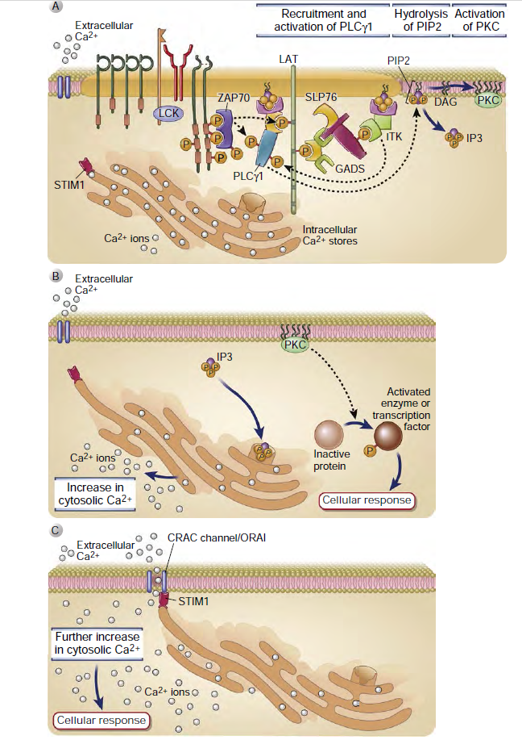
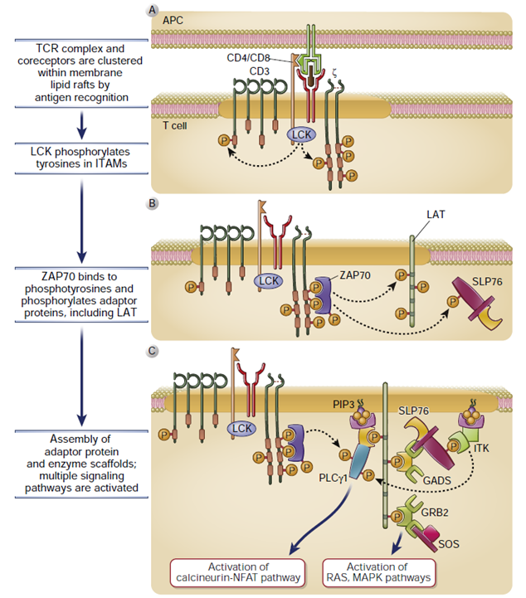
TCR signal pathways

Slide 13

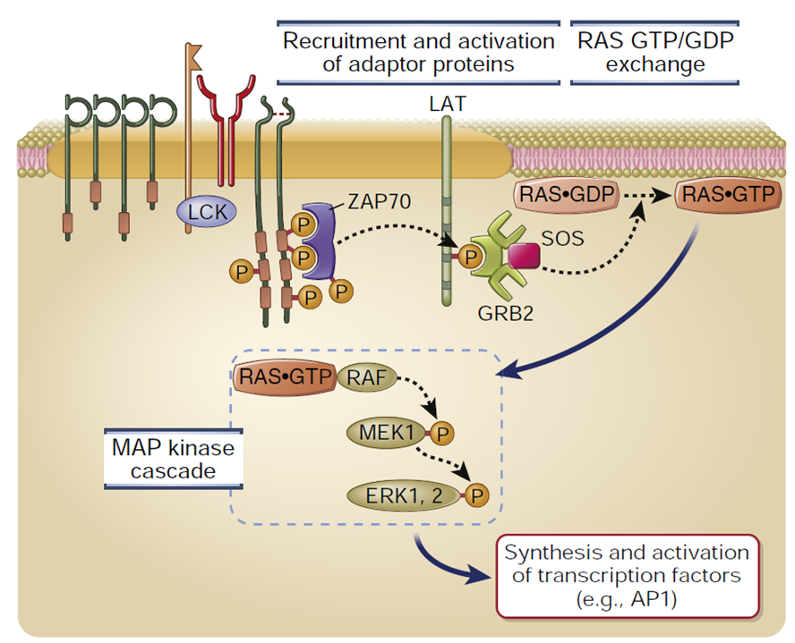
TCR signal pathways

Slide 14
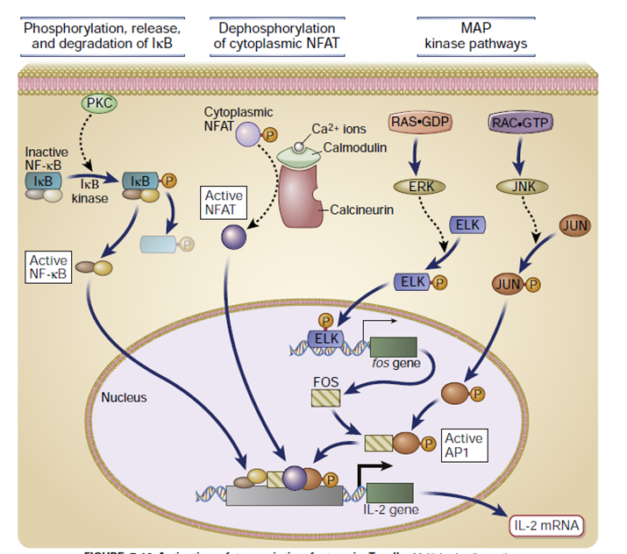
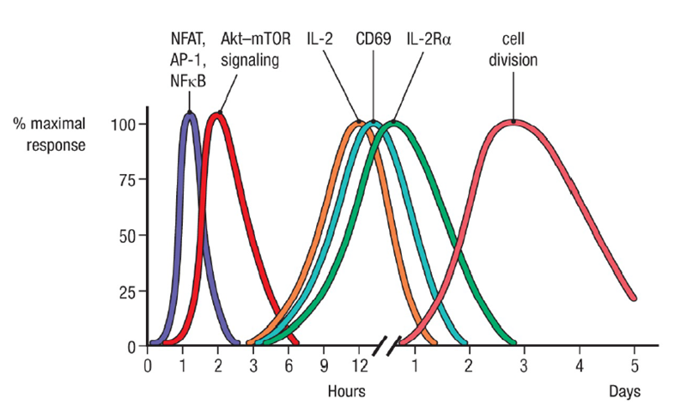
Antigen-induced activation of naive T cells initiates changes in morphology, metabolic activity, and progression into the cell cycle

Slide 15
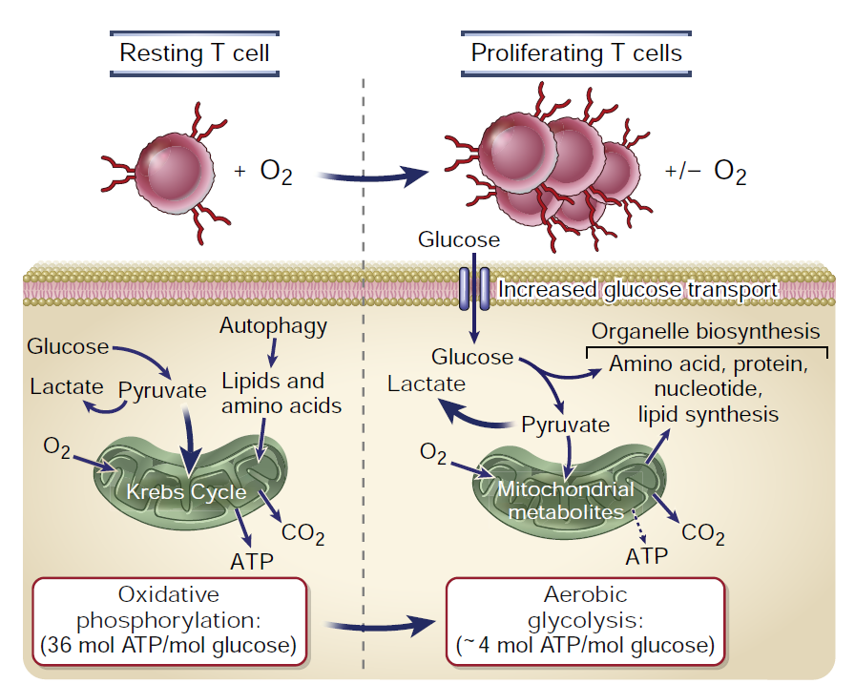
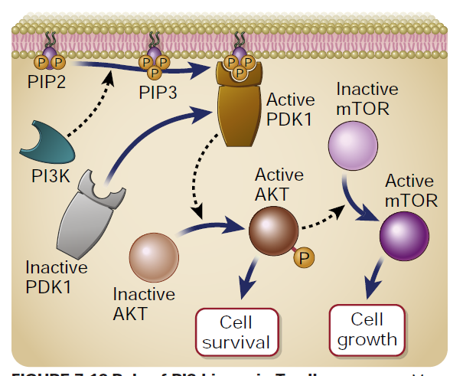
Metabolic Changes During T Cell Activation

Slide 16
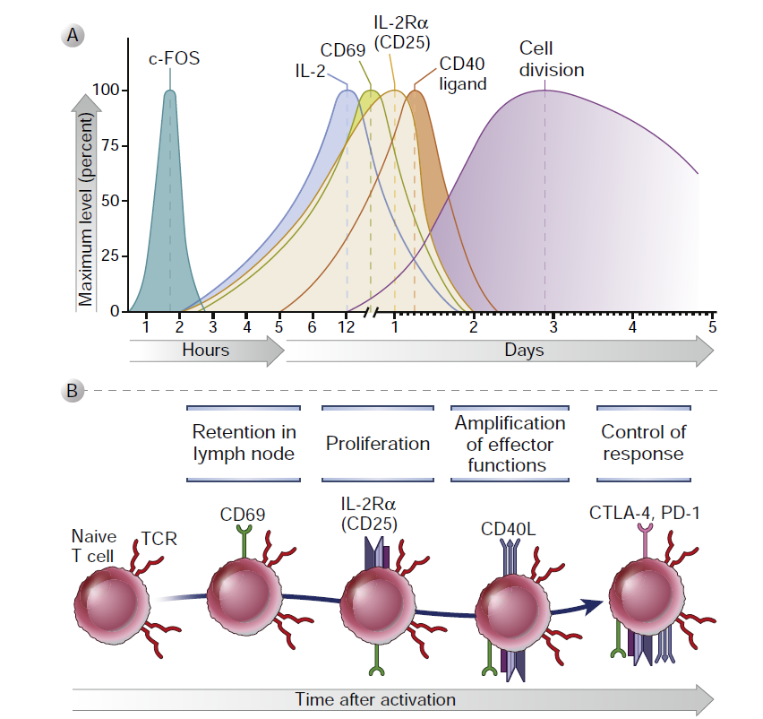
Changes in surface molecules after T cell activation

Slide 17
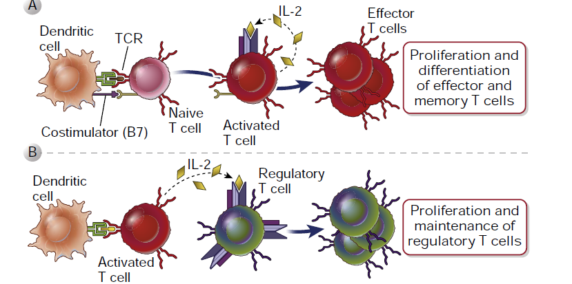
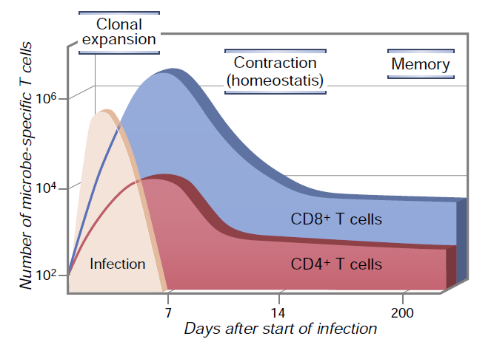
Cytokines in T Cell Activation and clonal expansion

Slide 18
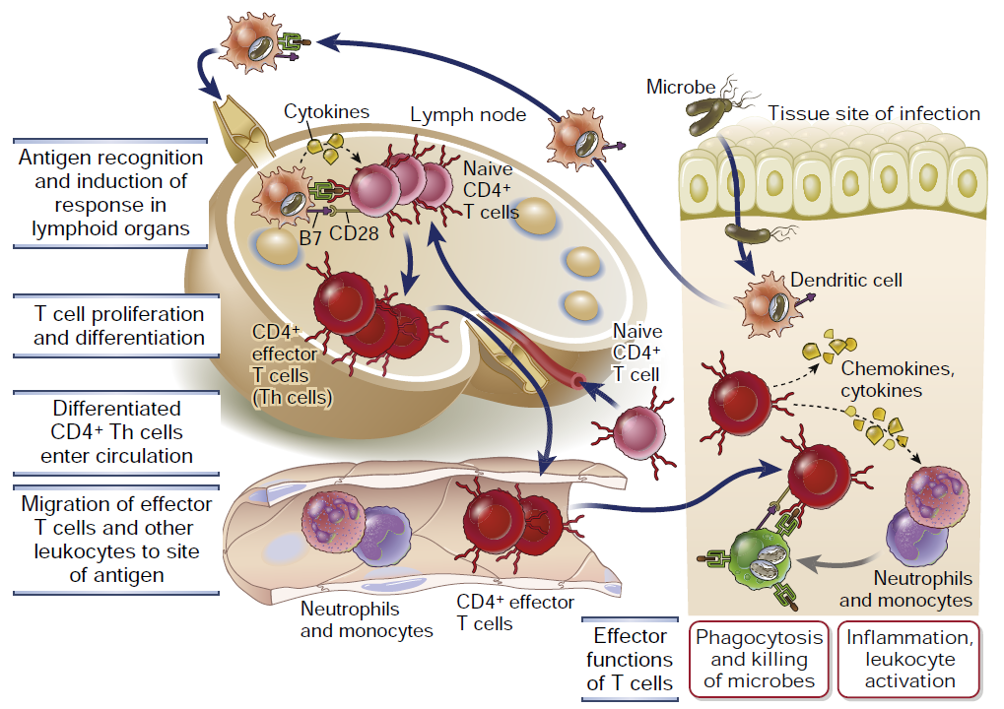
Overview of CD4+ T cell–mediated immune responses

Slide 19
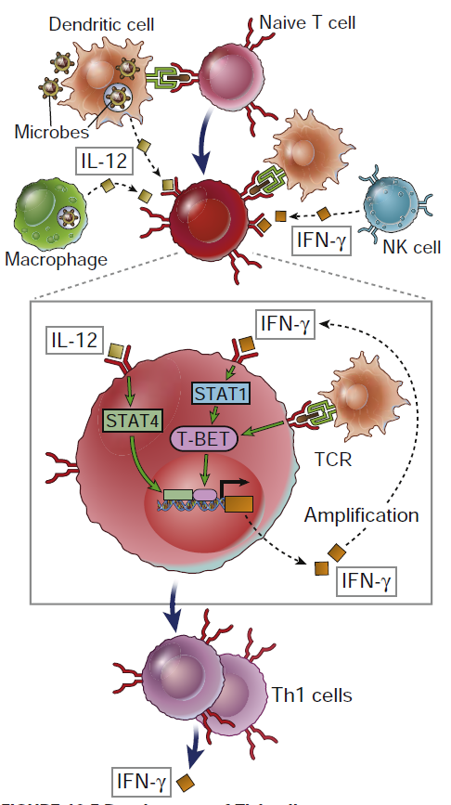
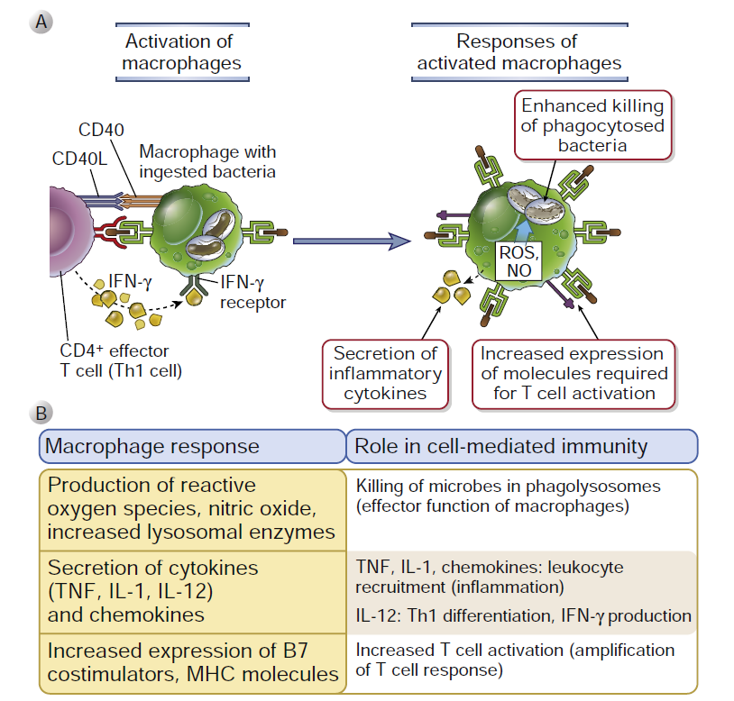
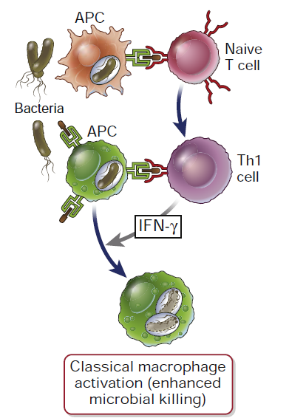
Functions of Th1 Cells

Slide 20
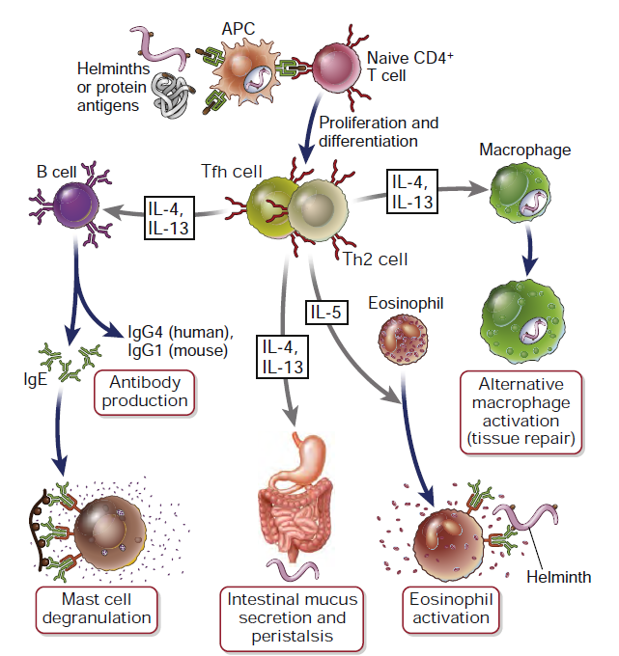
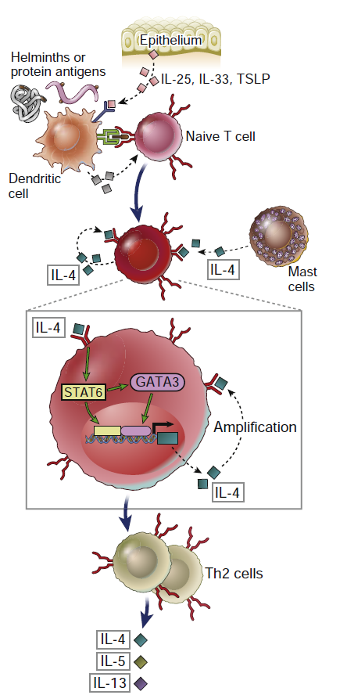
Functions of Th2 Cells

Slide 21
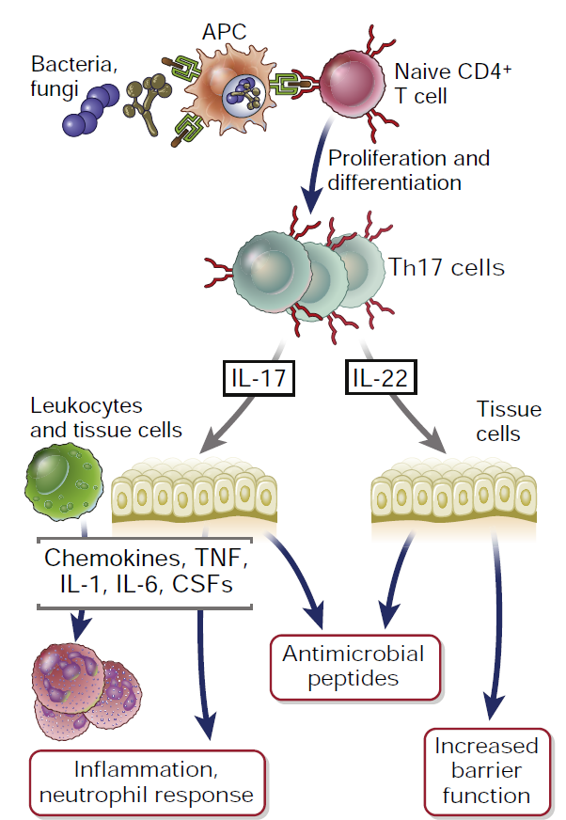
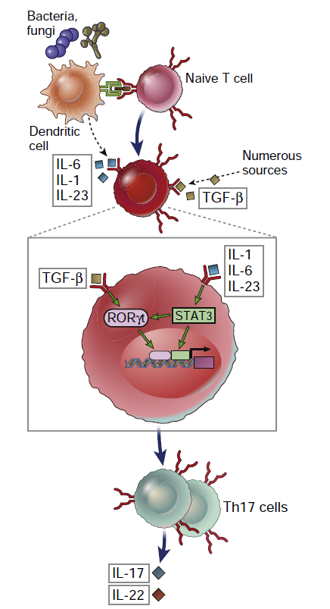
Functions of Th17 Cells

Slide 22
T Cell Subsets

Slide 23
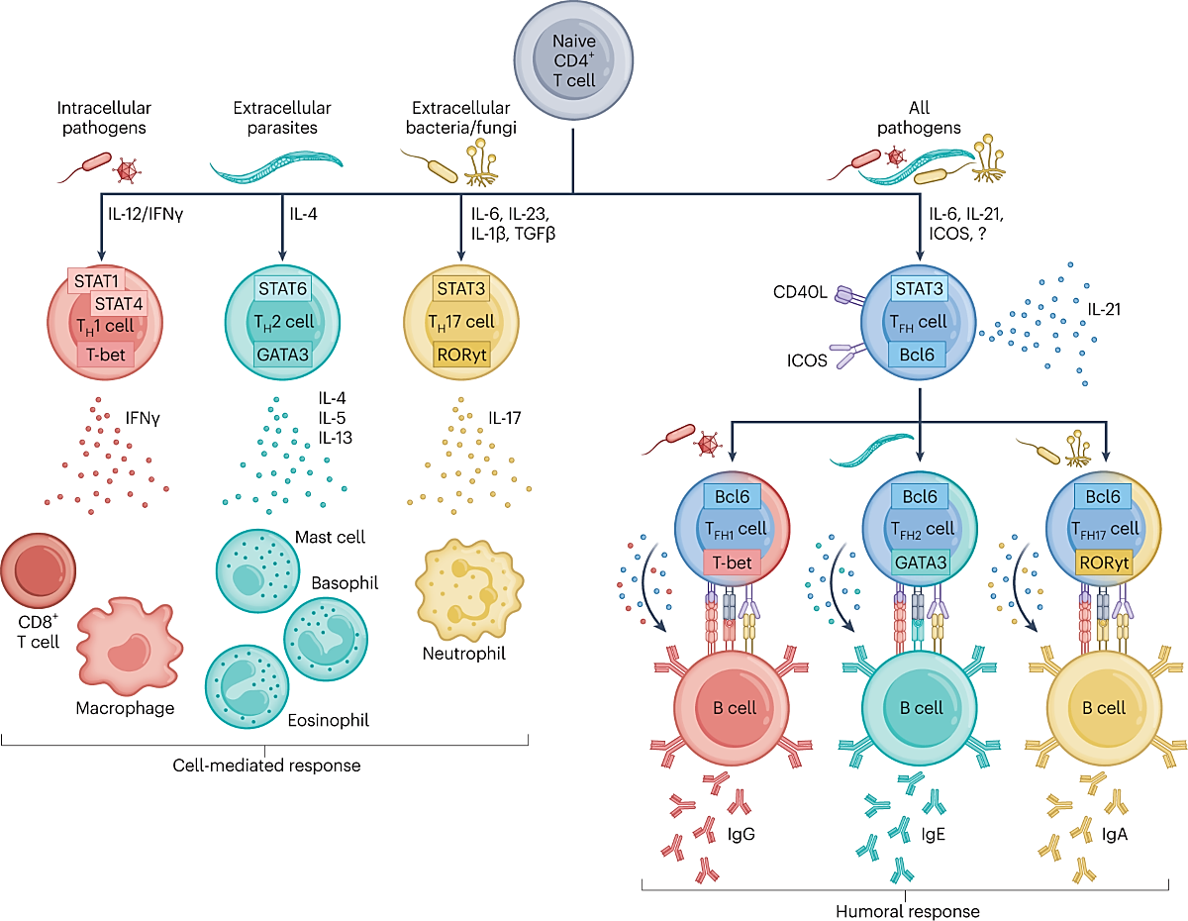
CD4+ T cell subtypes

Slide 24
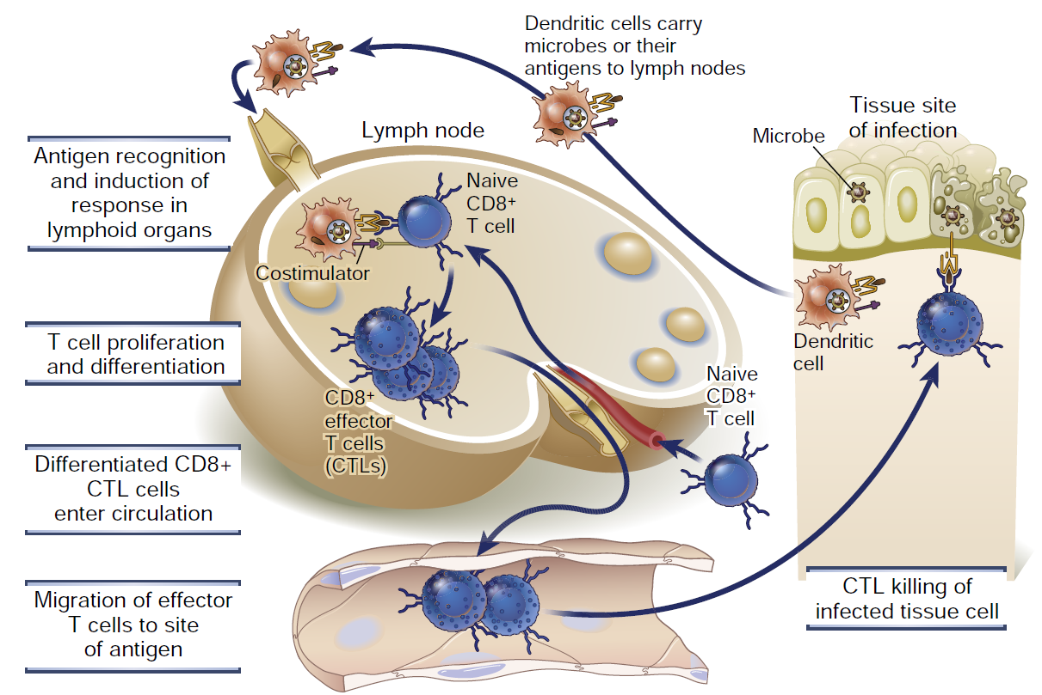
Induction and effector phases of CD8+ T cell responses

Slide 25
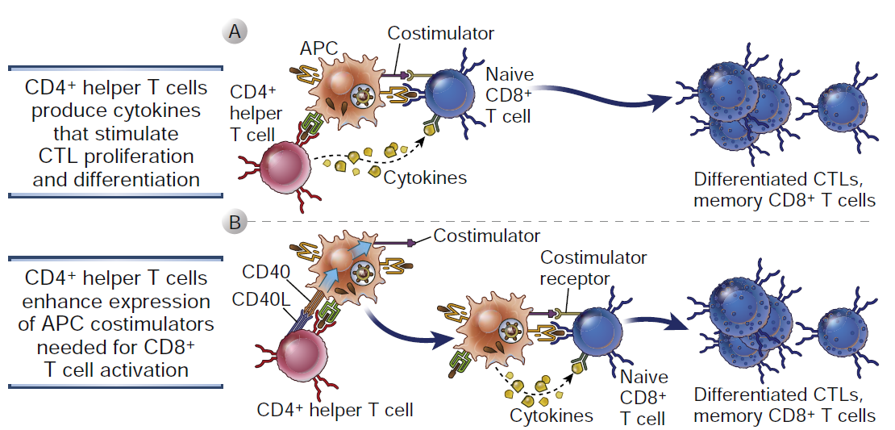
Role of helper T cells in the differentiation of CD8+ T lymphocytes

Slide 26
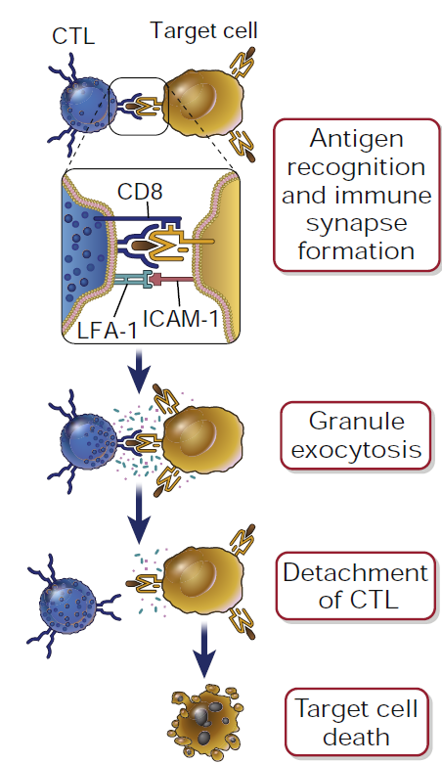
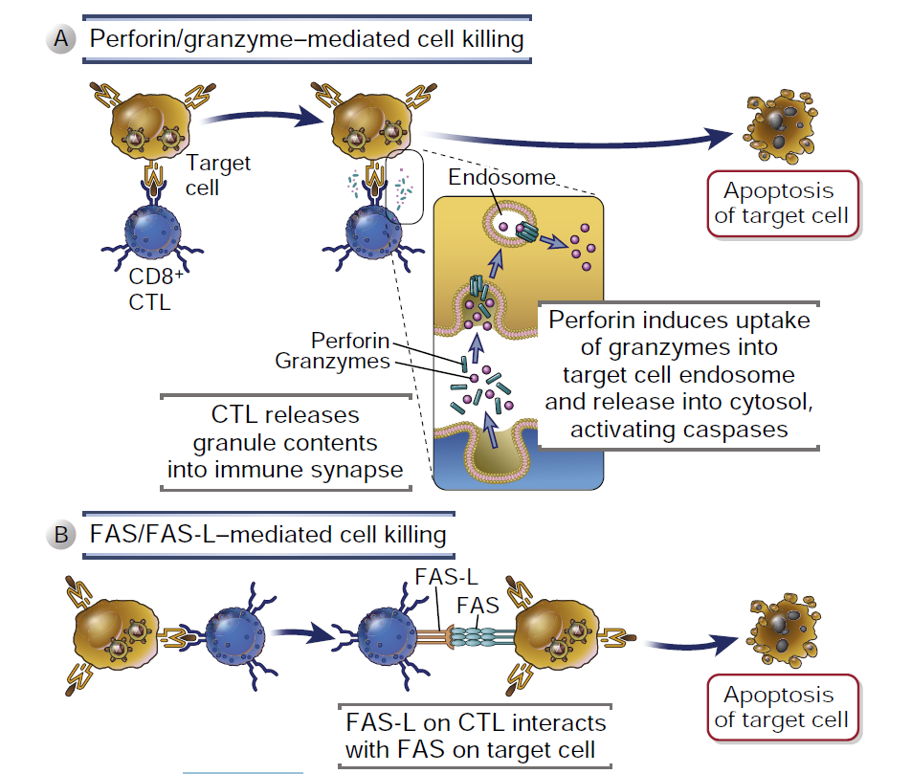
Steps and Mechanisms in cytotoxic T lymphocyte–mediated lysis of target cells

Slide 27
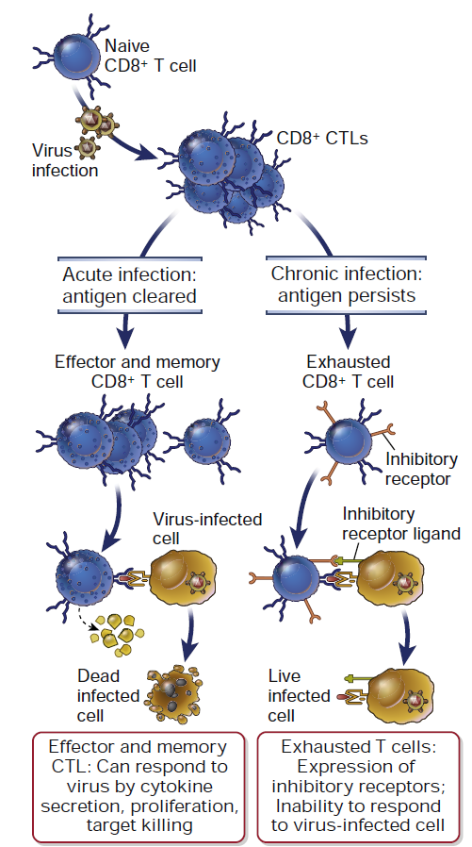
Inhibition of CD8+ T Cell Responses: T Cell Exhaustion
PD-1 (programmed cell death protein-1)
CTLA-4
TIM-3
LAG-3

Slide 28
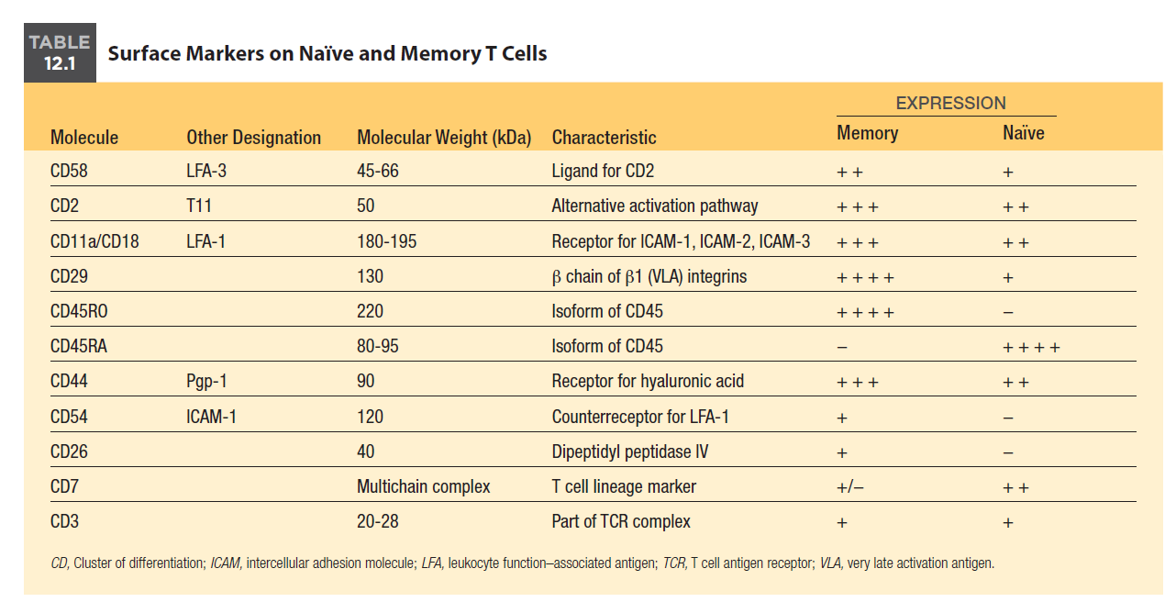
Naïve Versus Memory T Cells

Slide 29
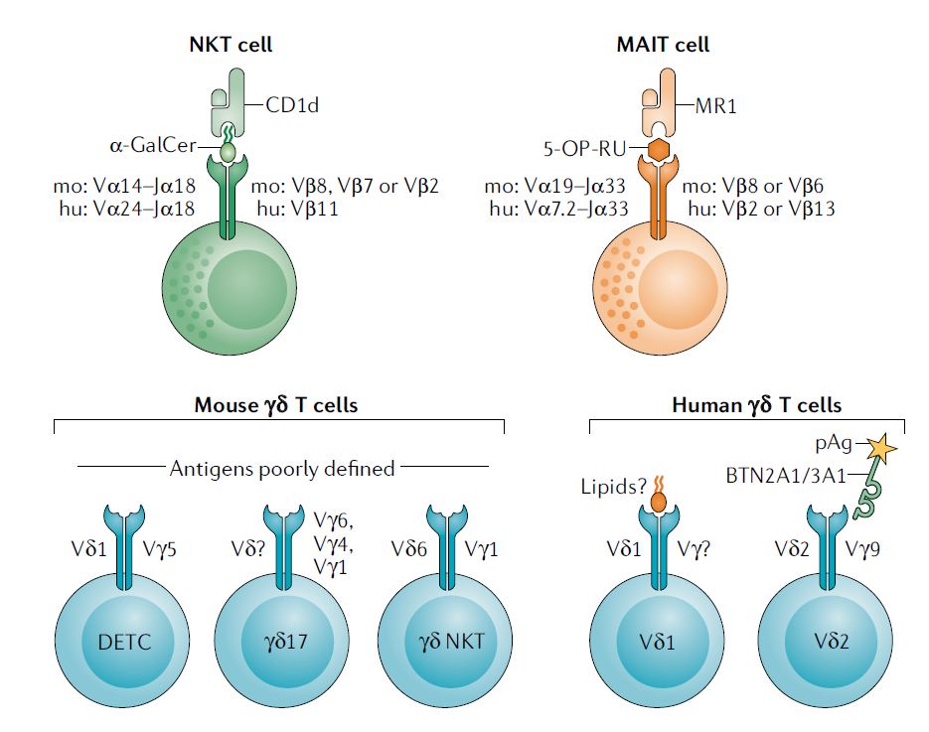
Non-conventional and Inate T Cells
Most unconventional T cells co- express surface antigens associated with NK cells (for example, CD161 in humans and NK1.1 in mice) and mount potent cytokine responses very rapidly after activation.
Representing > 45% of liver lymphocytes and 2–5% of the T cells in human blood.
MAIT cells recognize a limited array of microbial- derived vitamin B metabolites presented by MR1, which is β 2M- associated.
(MHC- related 1)
Representing 0.5–16% of T cells in different tissues.
()
Human γ δ T cells are dominated by a population of Vγ 9–Vδ 2+ T cells that potently respond to butyrophilin and phosphorylated prenyl Ag expressed by a diverse array of bacteria.

Slide 30

References
Firestein & Kelley’s Textbook of Rheumatology. 11th edition. 2021
Cellular and Molecular Immunology. 10th edition. 2022
Thymic development of unconventional T cells: how NKT cells, MAIT cells and γδ T cells emerge. Nat Rev Immunol. 2020 Dec;20(12):756-770.
NKT cell networks in the regulation of tumor immunity. Front Immunol. 2014 Oct 28;5:543.

Slide 31





Shahid Beheshti University of Medical Sciences
Tehran, Iran
fyeganeh@gmail.com
09127200243
Immunology Dept. SBMU

