Slide 1

Cells of the immune system
Farshid Yeganeh, PhD
Immunology Dept.
Shahid Beheshti University of Medical Sciences

Slide 2
Learning Objectives
By the end of this lesson, medical students should be able to:
Identify and describe the main types of immune cells.
Explain the roles of each immune cell in innate and adaptive immune responses.
Relate immune cell dysfunctions to clinical diseases and disorders.
Understand key laboratory findings used to diagnose immune cell-related diseases.

Slide 3
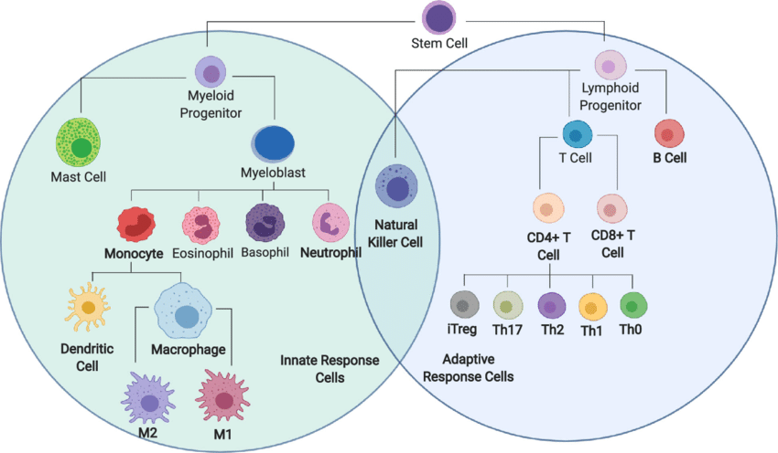
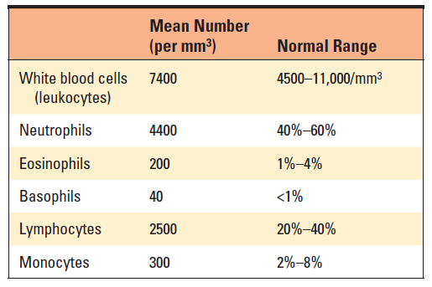
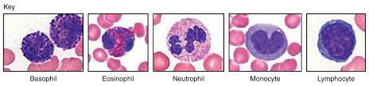
Immune cells
Cellular and Molecular Immunology, 10th edition
BMC Bioinformatics, 2019

Slide 4
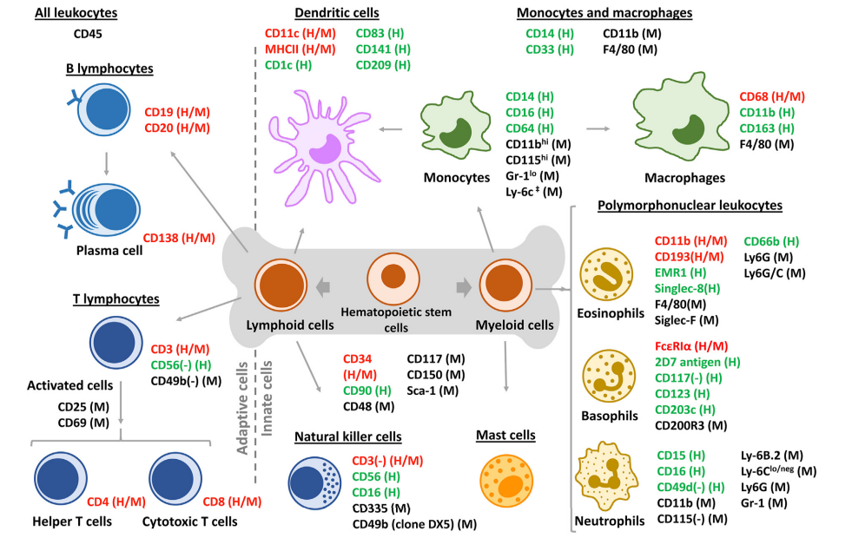
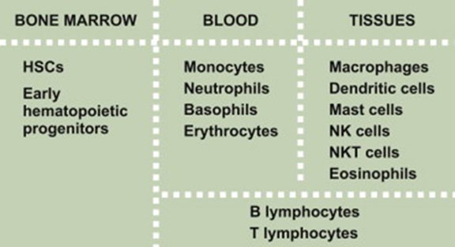
Hematopoiesis
Acta Pharmaceutica Sinica B; Volume 11, Issue 4; April 2021, Pages 852-870

Slide 5
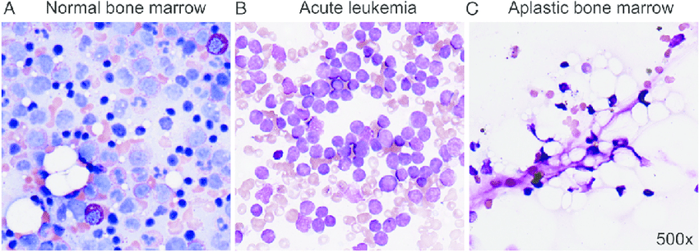
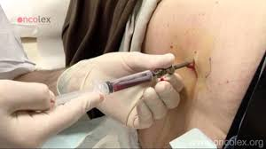
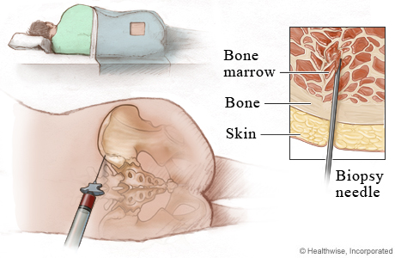
Bone marrow disorders
Pediatr Rev. 2016 Mar; 37(3): 101–113.

Slide 6
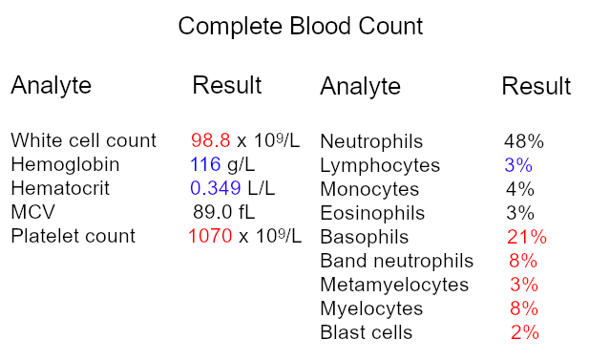
What is your clinical diagnosis?

Slide 7
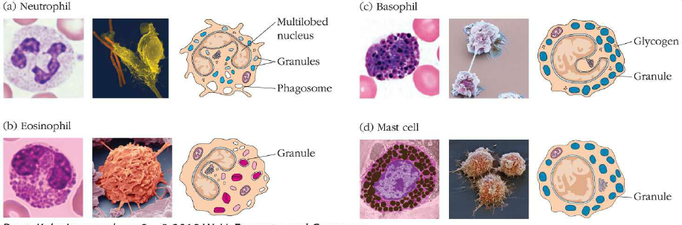
Granulocytes
Coby immunology 2018

Slide 8
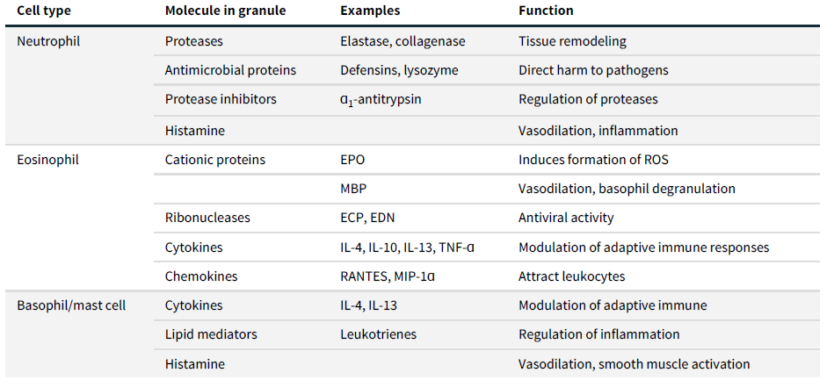
Examples of proteins in granules
Coby immunology 2018

Slide 9
Neutrophils
Key Features
Most abundant WBC (~50–70%)
Short lifespan (hours–days)
First responders to infection (especially bacteria/fungi)
Neutrophils: Functions
Phagocytosis of microbes
Granule release → proteases, myeloperoxidase, ROS
Neutrophil Extracellular Traps (NETs)
Chromatin + granule proteins trap/kill microbes
Eosinophils: defense against parasites, allergy
Basophils: rare, circulate, allergy responses
Mast cells: tissue-resident, central in immediate hypersensitivity

Slide 10
Monocytes & Macrophages
Monocytes & Macrophages: Features
Monocytes: circulate in blood → differentiate into tissue macrophages
Long-lived cells in tissues (e.g., Kupffer cells, microglia, alveolar macrophages)
Macrophage Functions
Phagocytosis (microbes, dead cells)
Cytokine secretion (IL-1, TNF-α, IL-12) → inflammation, immune activation
Antigen presentation → activate T cells (bridge to adaptive immunity)
Macrophage Polarization
M1 phenotype: pro-inflammatory, microbicidal, tumoricidal
M2 phenotype: anti-inflammatory, tissue repair, fibrosis
Clinical relevance: chronic inflammation, tumor-associated macrophages

Slide 11
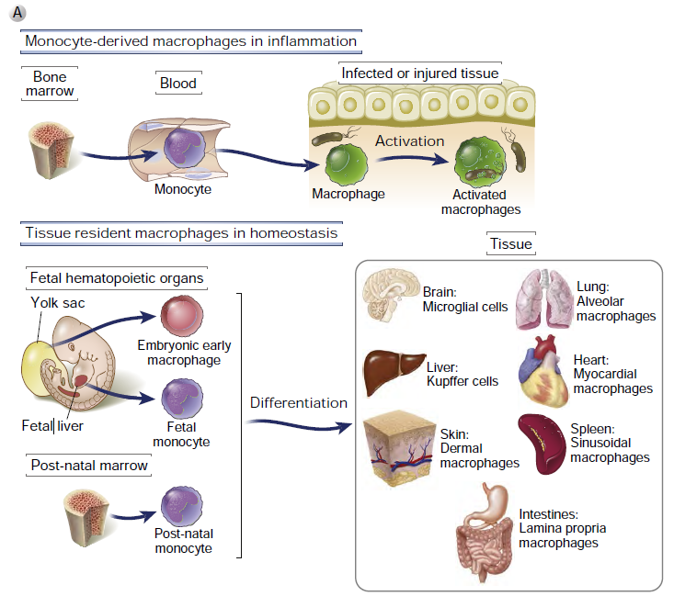
Maturation of mononuclear phagocytes

Slide 12
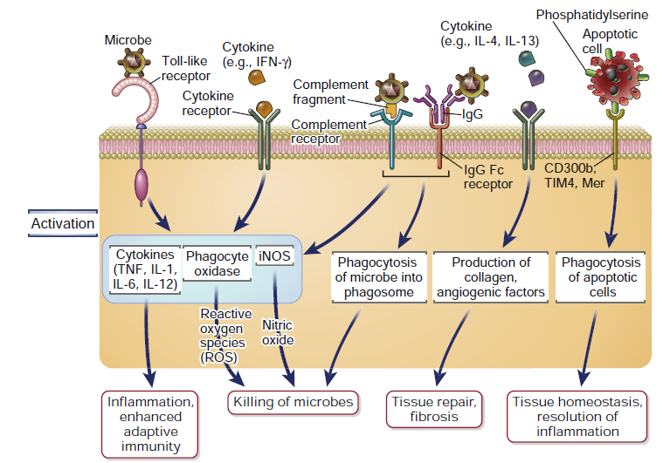
Functions of macrophages
Cellular and Molecular Immunology, 10th edition

Slide 13
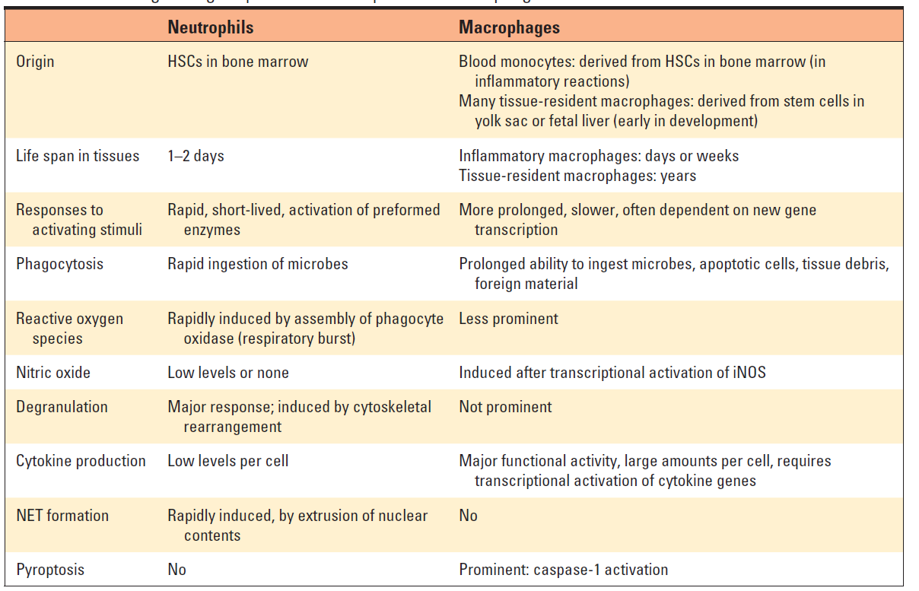
Distinguishing Properties of Neutrophils and Macrophages

Slide 14
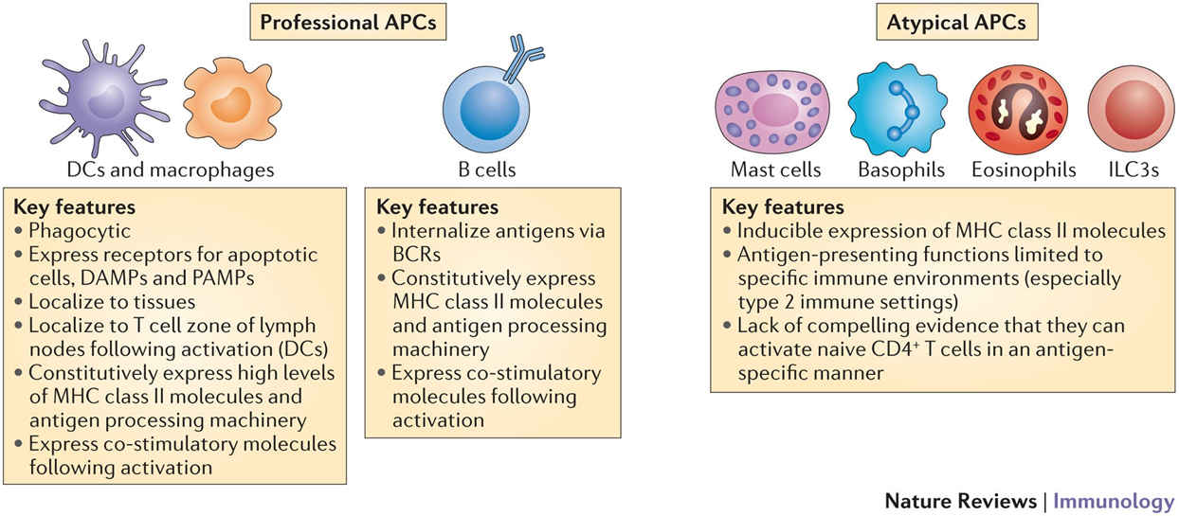
Antigen-Presenting Cells

Slide 15
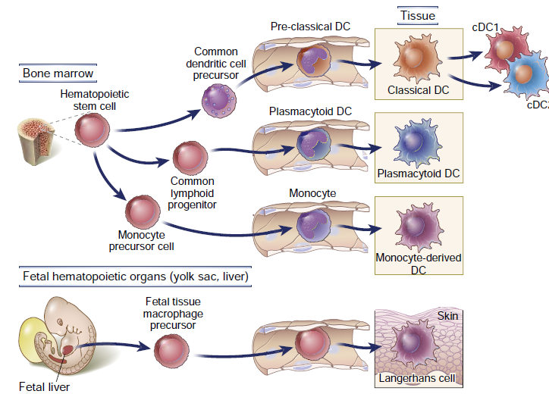
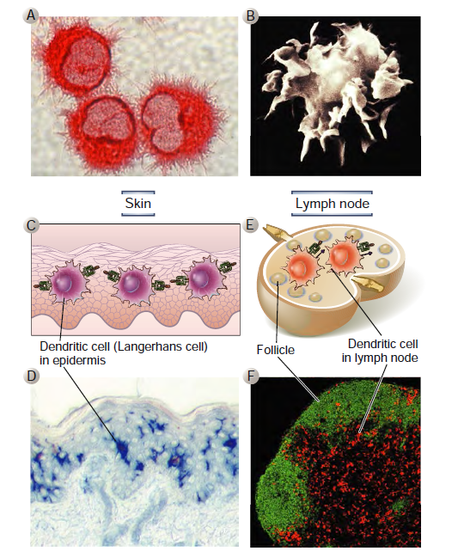
Dendritic cells

Slide 16
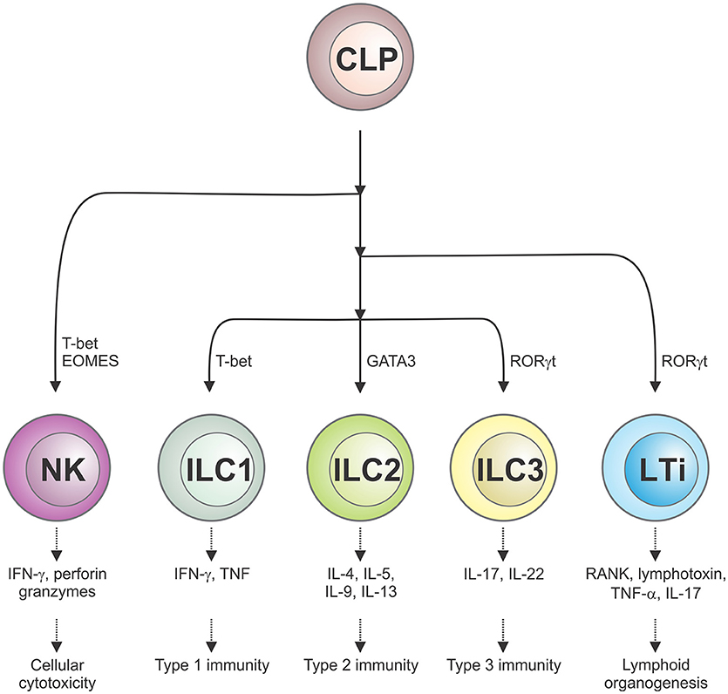
Innate Lymphoid Cells (ILC)
Front. Immunol., 11 July 2019

Slide 17
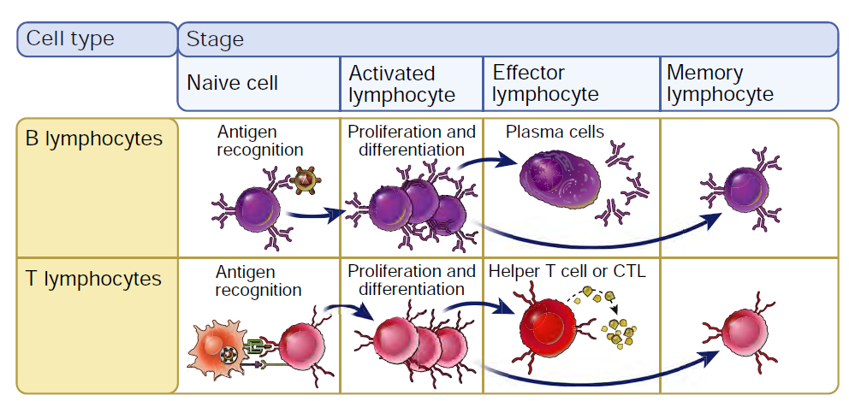
Cells of adaptive immune system (Lymphocytes)
Cellular and Molecular Immunology, 10th edition

Slide 18
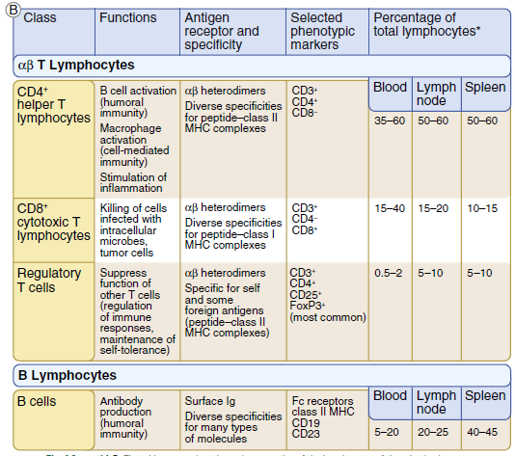
Lymphocytes
Basic Immunology 2019

Slide 19
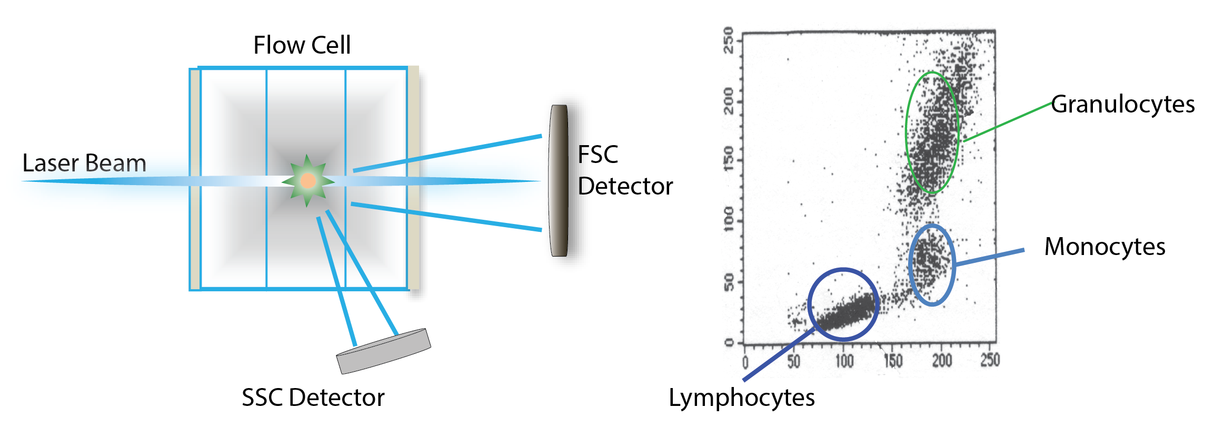
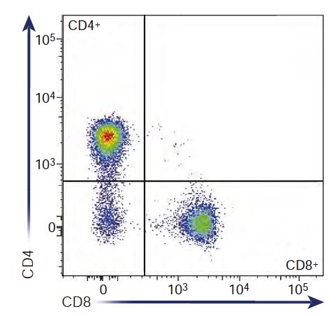
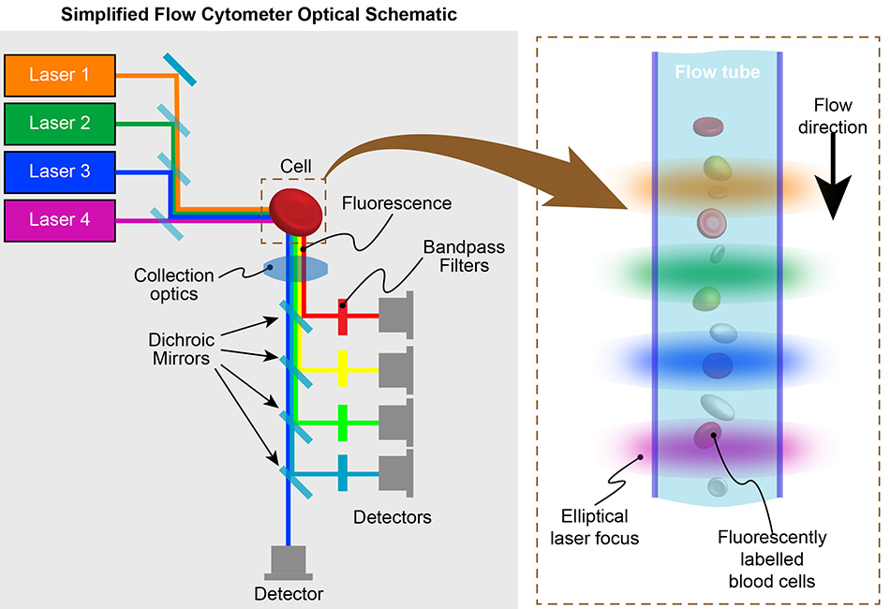
Immune cells

Slide 20
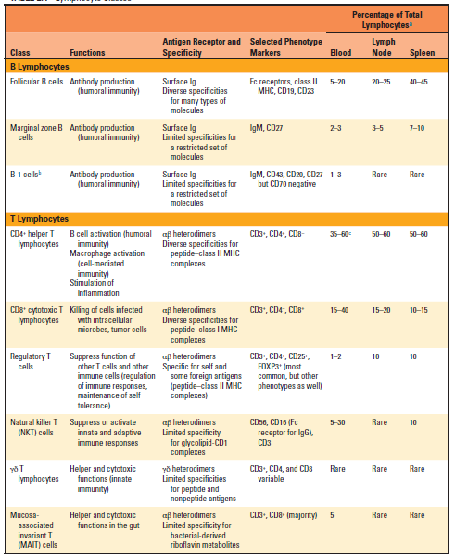
Lymphocytes
Cellular and Molecular Immunology, 10th edition

Slide 21
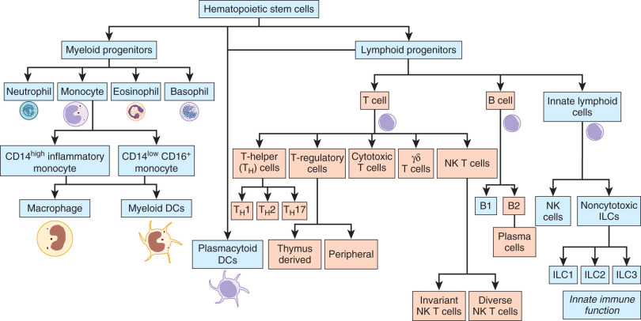
Immune cells
Avery's Diseases of the Newborn (Tenth Edition) 2018, Pages 1187-1197.e4

Slide 22
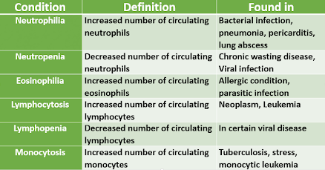
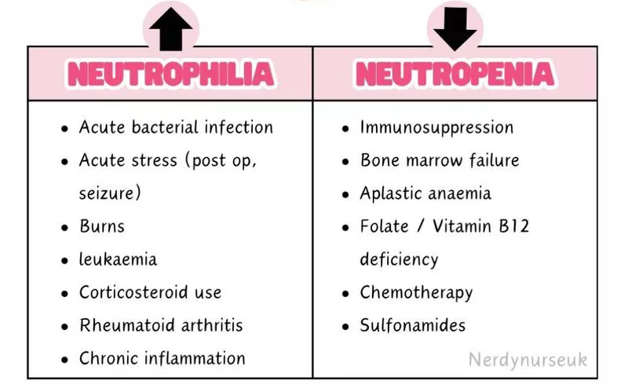
Leukocytes disorders

Slide 23
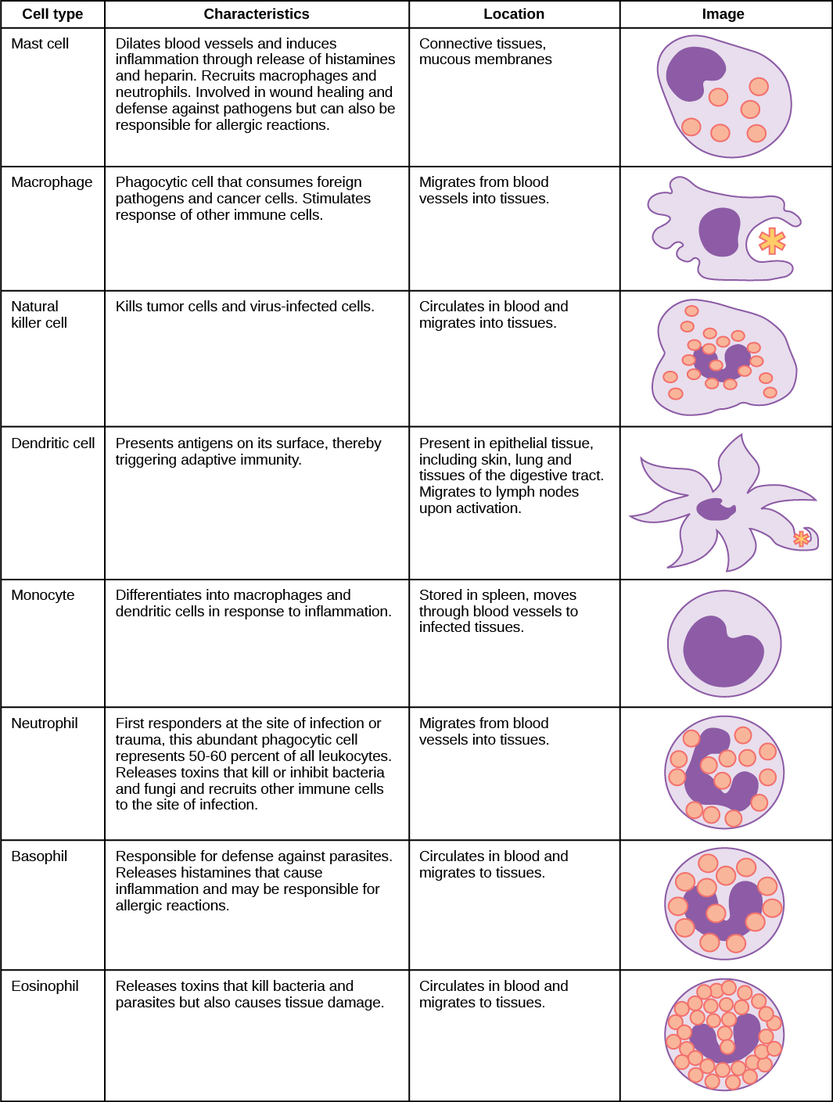

Take home message
Cellular and Molecular Immunology, 10th edition

Slide 24

References

Slide 25
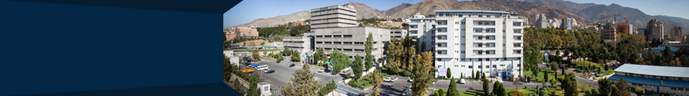




Shahid Beheshti University of Medical Sciences
Tehran, Iran
fyeganeh@gmail.com
09127200243
Immunology Dept. SBMU

