Slide 1

Antigens and Super antigens for MD students
Farshid Yeganeh, PhD
Immunology Dept.
Shahid Beheshti University of Medical Sciences,

Slide 2
Learning Objectives
At the end of my presentation, students should be able to …
Define what antigens are and describe their role in the immune response.
Differentiate between various types of antigens.
Understand the concepts of epitopes and immunogenicity.
Discuss the characteristics and implications of superantigens in pharmacology.

Slide 3
Features of Biologic Antigens
Ladislas Deutsch (1874–1939) coined the term antigen.
An antigen is any substance that may be specifically bound by an B cell receptor (antibody molecule) or T cell receptor.

Slide 4
Types of Ag
Category | Type of Antigen | Description | Examples
Based on Origin | Exogenous Antigens | Enter the body from external sources and are processed by antigen-presenting cells (APCs). | Bacteria, viruses, pollen, dust
 | Endogenous Antigens | Produced within the body, often due to infection or cell metabolism, and presented via MHC class I molecules. | Viral proteins in infected cells, cancer cell proteins
 | Autoantigens | Self-antigens recognized as foreign in autoimmune diseases. | Autoantibodies in lupus, rheumatoid arthritis
 | Tumor Antigens | Produced by cancer cells; can be either unique to tumors or overexpressed in them. | Tumor-specific or tumor-associated antigens
Based on Immune Response | T-Dependent Antigens | Require the assistance of T-helper cells to elicit an immune response. | Most protein antigens (e.g., viral capsid proteins)
 | T-Independent Antigens | Can activate B cells without T-helper cell involvement, often resulting in a faster but weaker immune response. | Bacterial polysaccharides, lipopolysaccharides (LPS)
Based on Structure | Proteins | Highly immunogenic and structurally diverse; provoke strong immune responses. | Viral proteins, bacterial exotoxins
 | Polysaccharides | Often T-independent, less diverse than proteins. | Bacterial capsules (e.g., Streptococcus pneumoniae)
 | Lipids | Less immunogenic than proteins or polysaccharides; sometimes part of complex antigens. | Lipopolysaccharides (LPS) in Gram-negative bacteria
 | Nucleic Acids | Weakly immunogenic, but can become more immunogenic when associated with proteins. | Viral genomes, nucleoproteins
Based on Immunogenicity | Immunogens | Capable of inducing an immune response. | Pathogen proteins, vaccines
 | Haptens | Small molecules that become immunogenic only when attached to larger carrier proteins. | Drug molecules (e.g., penicillin), poison ivy resin

Slide 5
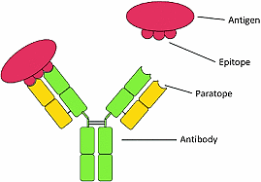
Determinant or Epitope
Any antibody binds to only a portion of the macromolecule, which is called a determinant or an epitope.
The part of an antibody that binds to the epitope is called a paratope.
Haptens are small molecules that elicit an immune response only when attached to a large carrier such as a protein; the carrier may be one that also does not elicit an immune response by itself.

Slide 6
Factors Affecting Immunogenicity of an Antigen
Factor | Description
Nature of the Antigen | - Size: Larger molecules are more immunogenic. - Complexity: More complex antigens are stronger. - Foreignness: The more different from self, the more immunogenic. - Chemical Nature: Proteins > Polysaccharides > Lipids/Nucleic acids. - Degradability: Easily degradable antigens are more immunogenic.
Dosage and Route of Administration | - Dose: Intermediate doses are optimal for a strong response. - Route: Subcutaneous/intramuscular routes are more immunogenic than oral/intravenous routes.
Use of Adjuvants | - Adjuvants enhance immune response by stimulating the immune system and increasing antigen exposure.
Genetic Makeup of the Host | - MHC Genes: Variations affect antigen presentation and response. - Genetic Predisposition: Some individuals are genetically predisposed to stronger/weaker responses.
Age of the Host | - Young and Elderly: Neonates and elderly have weaker immune responses due to immature or aging immune systems.
Health Status of the Host | - Immunocompromised individuals have weaker immune responses. - Pre-existing Immunity: Can enhance or dampen responses. - Chronic Illness: Conditions like diabetes can impair immune responses.
Antigen Processing and Presentation | - Proper processing by antigen-presenting cells (APCs) and presentation by MHC molecules is crucial for a strong response.
Physical Form of the Antigen | - Particulate antigens are more immunogenic than soluble forms. - Aggregated antigens or multivalent forms enhance immunogenicity.
Antigen Persistence | - Duration of Exposure: Persistent antigens promote stronger and longer-lasting immune responses.

Slide 7
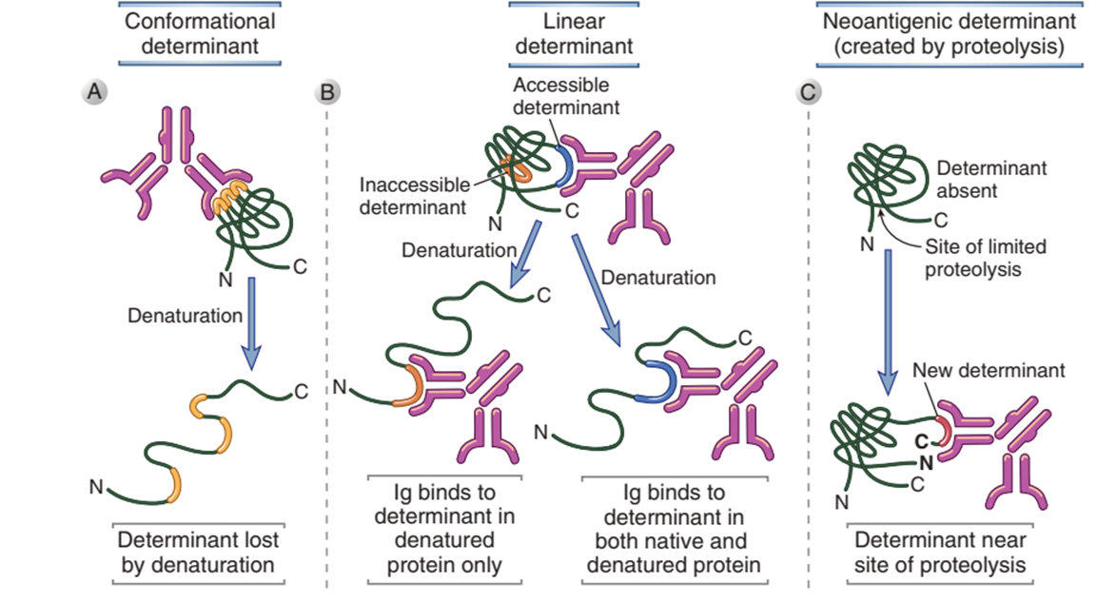
The nature of antigenic determinants

Slide 8
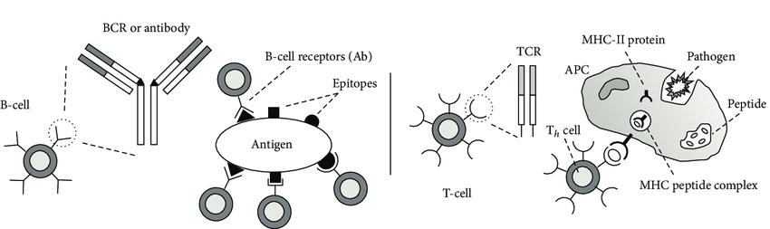
B-cell and T-cell pattern recognition of an antigen

Slide 9
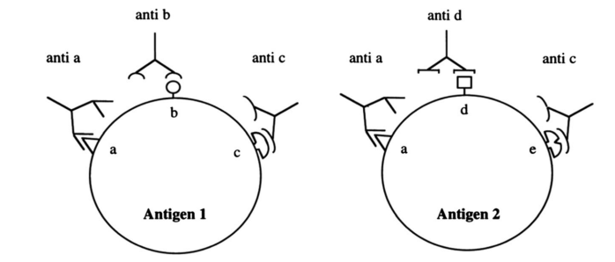
Cross-reactivity
Epitopes are sometimes cross-reactive.

Slide 10
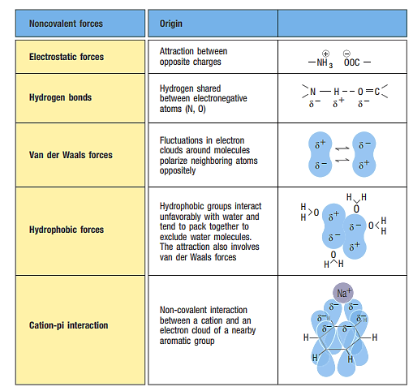
Interactions basis of antigen-receptor binding
1- Structural Complementarity

Slide 11
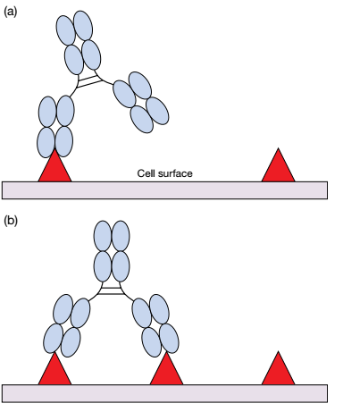
Basis of Antigen Binding
Affinity
Avidity

Slide 12
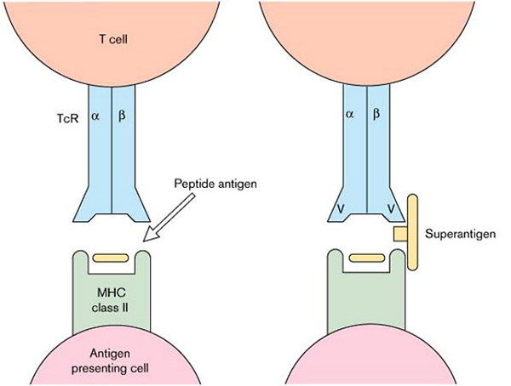
Superantigens are extremely powerful activators of T‐cells
Superantigens (SAgs) are microbial peptides that can activate the immune system and contribute to autoimmune disorders.
Instead of binding to the highly variable peptide groove of the T-cell receptor as classic antigens do, SAGs interact with the more conserved Vβ region.
Another unique feature of SAGs is that they can activate T lymphocytes in the absence of costimulatory molecules.
one SAgs can activate between 2% and 20% of circulating T lymphocytes, as opposed to 0.001% to 0.01% with conventional antigens.
The polyclonal activation of such a large number of T-cells leads to an uncontrolled release of pro-inflammatory cytokines, including tumor necrosis factor (TNF), interleukin-1 (IL-1), and interleukin-2 (IL-2), causing systemic immune dysregulation.

Slide 13
Superantigens are extremely powerful activators of T‐cells
Superantigens are often produced by certain bacteria and viruses. Examples include:
Staphylococcal Enterotoxins (SEs): Produced by Staphylococcus aureus, responsible for food poisoning and toxic shock syndrome.
Toxic Shock Syndrome Toxin-1 (TSST-1): Also produced by Staphylococcus aureus, leading to toxic shock syndrome.
Streptococcal Pyrogenic Exotoxins (SPEs): Produced by Streptococcus pyogenes, contributing to conditions like streptococcal toxic shock syndrome (STSS) and scarlet fever.

Slide 14
SAgs, Clinical and Pharmacological Importance
Clinical Importance The exaggerated immune response induced by SAgs has severe clinical consequences, including systemic inflammation, shock, and multi-organ failure.
Toxic Shock Syndrome (TSS) is characterized by high fever, hypotension, rash, vomiting, diarrhea, and multi-organ failure. If untreated, it can be fatal.
Food Poisoning: Ingestion of SEs from contaminated food triggers rapid activation of T-cells, leading to nausea, vomiting, abdominal cramps, and diarrhea.
Streptococcal Toxic Shock Syndrome (STSS): Like TSS, STSS presents with high fever, hypotension, and shock, often leading to multi-organ failure.
Autoimmune Diseases: Hypothesis: There is some evidence that superantigen exposure may contribute to autoimmune disease development. Superantigen-induced T-cell activation can lead to the breakdown of self-tolerance, promoting autoimmunity. Diseases such as rheumatoid arthritis, Kawasaki disease, and systemic lupus erythematosus (SLE) have been associated with superantigens in some cases.
Pharmacological Importance
Antibiotics, Immunomodulatory Therapy (Intravenous Immunoglobulin (IVIG)), Corticosteroids, Cytokine Blockade, Toxoid Vaccines, Monoclonal Antibodies

Slide 15

Take home message

Slide 16

References
Cellular and Molecular Immunology - 9th Edition – Elsevier
Roitt's Essential Immunology, 13th Edition

Slide 17





Shahid Beheshti University of Medical Sciences
Tehran, Iran
fyeganeh@gmail.com
09127200243
Immunology Dept. SBMU

