Slide 1

Complement
Farshid Yeganeh, PhD
Immunology Dept.
Shahid Beheshti University of Medical Sciences,

Slide 2
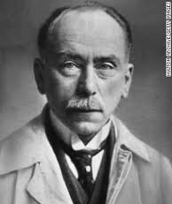
Introduction
The complement system is one of the major effector mechanisms of humoral immunity
Is an important effector mechanism of innate immunity.
Discovered by Jules Bordet 1890s

Slide 3
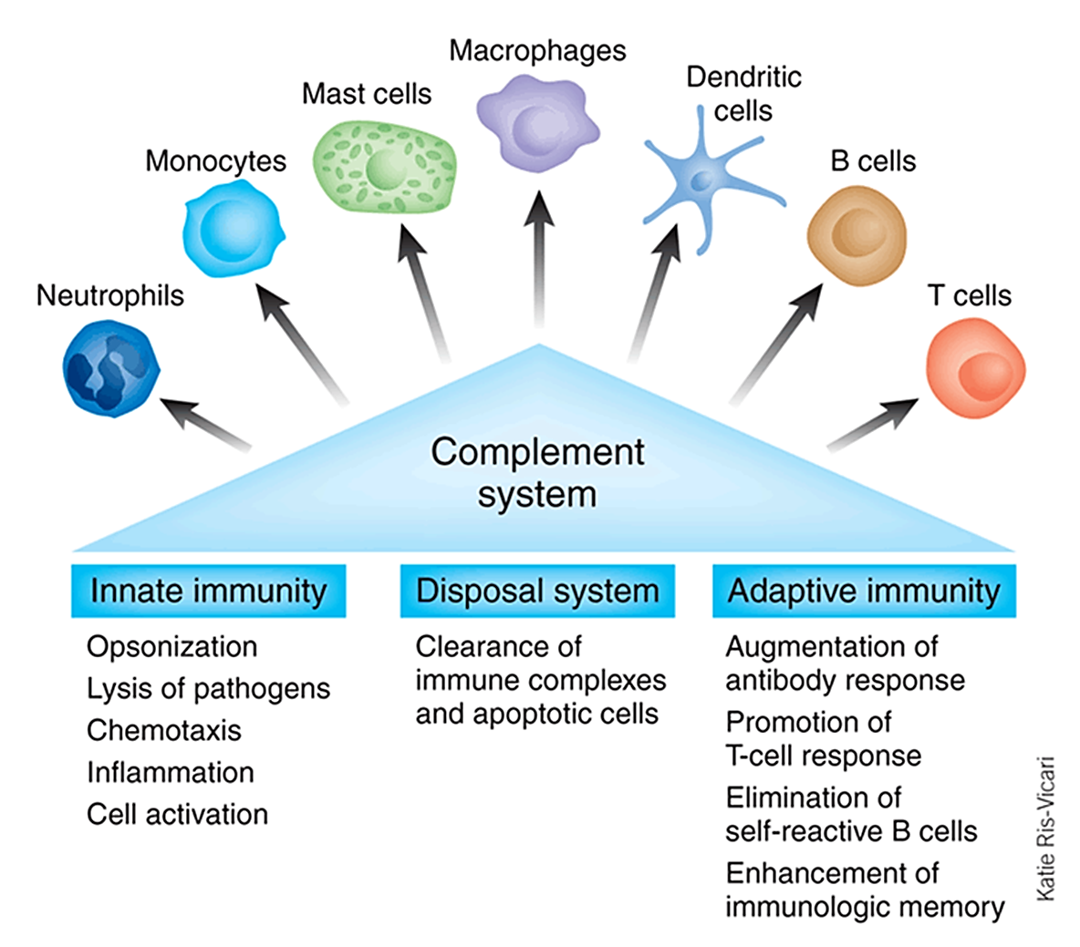
The importance of complement system

Slide 4
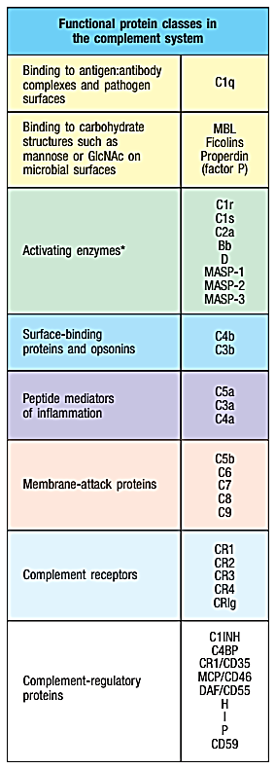
Components of the complement
The complement system is composed of more than 30 diﬀerent plasma and cell surface proteins, which are produced mainly by the liver.
Activation of complement involves the sequential proteolysis
zymogens

Slide 5
Complement nomenclature
Convertase
C₃
C₃b
C₃a

Slide 6
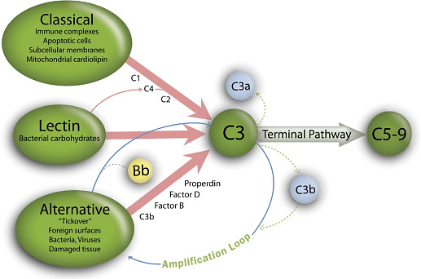
Activation of complement
American journal of obstetrics and gynecology, 2012

Slide 7
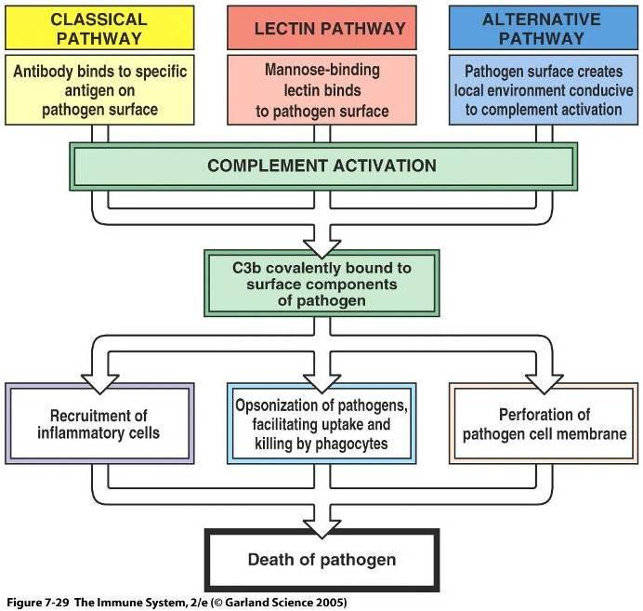

Slide 8

The classical pathway of complement activation

Slide 9
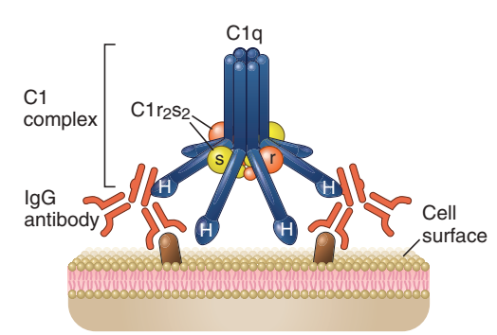
C1q Structure

Slide 10
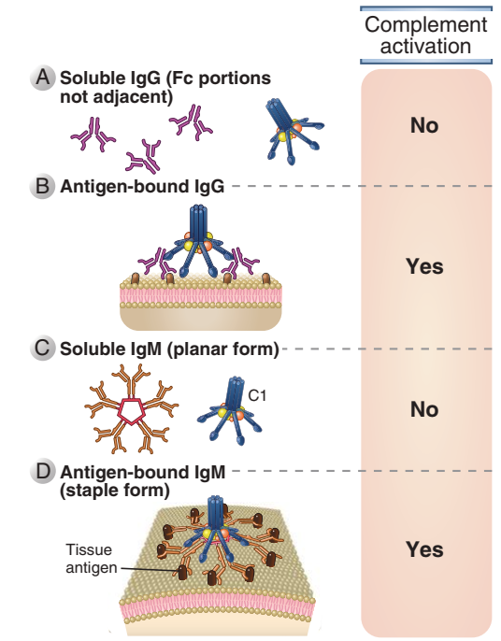
Classical pathway

Slide 11
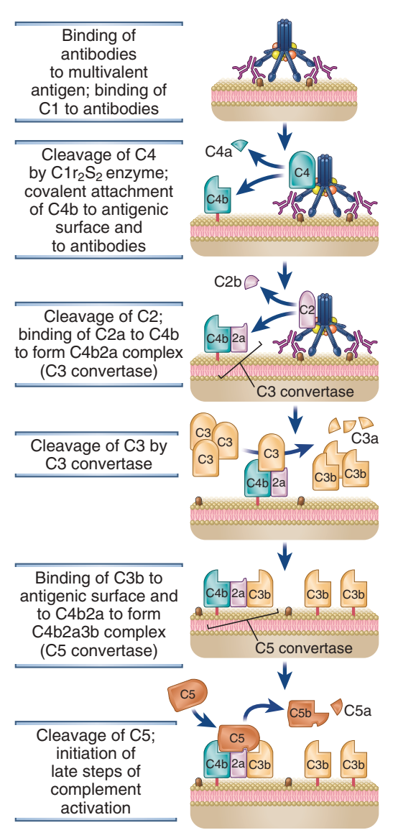
Classical pathway
The two molecules of active C1r cleave the two molecules of C1s. Once cleaved, the active C1s cleaves C4 into C4a and C4b.

Slide 12

The alternative pathway

Slide 13
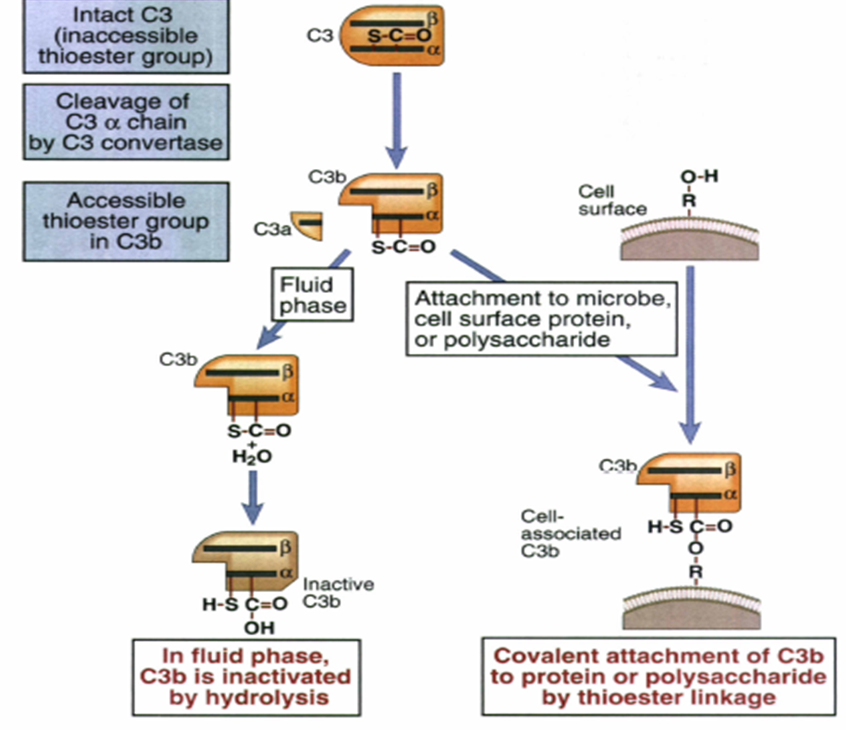
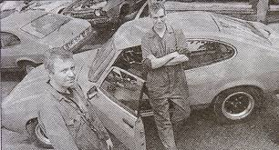
Alternative pathway
Tickover
The basis for this pathway is a spontaneous hydrolysis of C3, which occurs in the serum at a rate of 0.2% to 0.4% per hour.

Slide 14
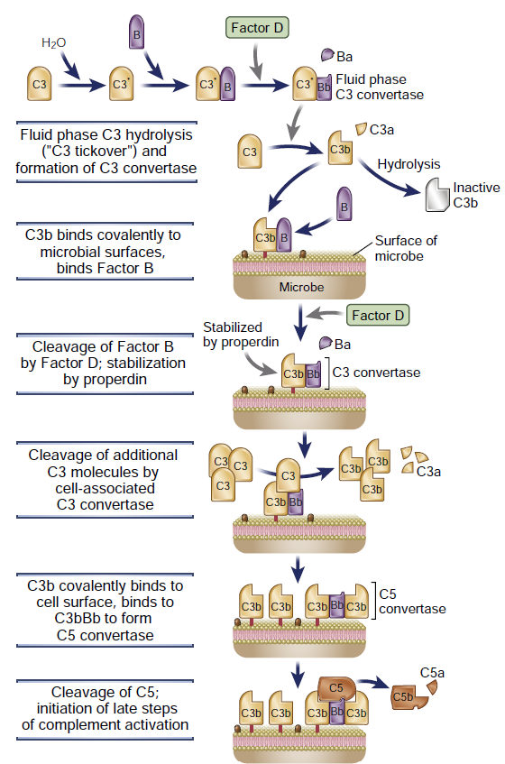
Alternative pathway

Slide 15
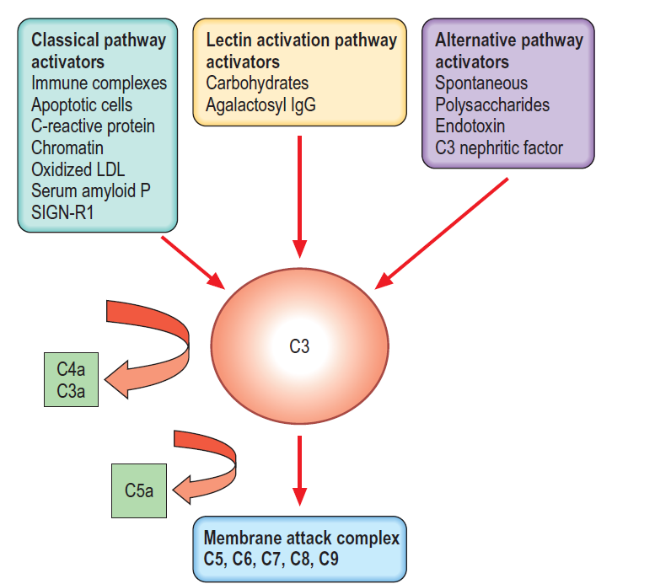

The activators of complements
Cobra Venom Factor (CVF), is the non-toxic, complement-activating component of cobra venom.
Like naturally occurring human C3b, CVF forms a complex, or convertase, with complement components Factor B and Factor D.
Middleton’s allergy principles and practice; 2020

Slide 16
The Lectin Pathway

Slide 17
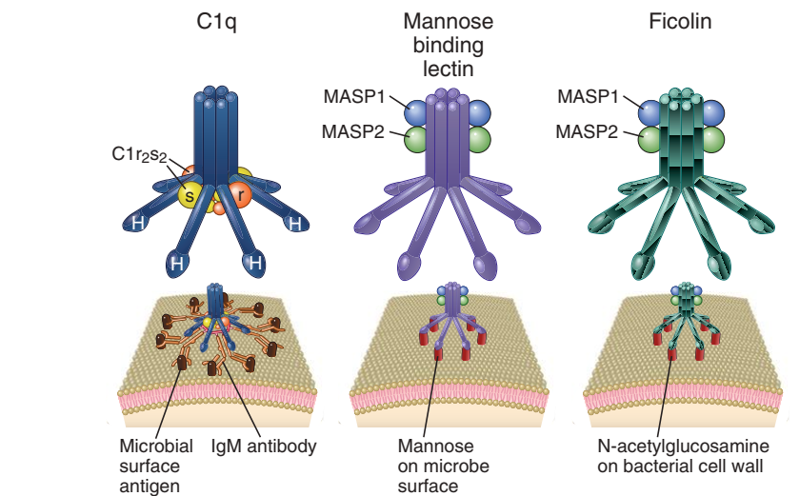
The lectin pathway uses soluble receptors that recognize microbial surfaces

Slide 18
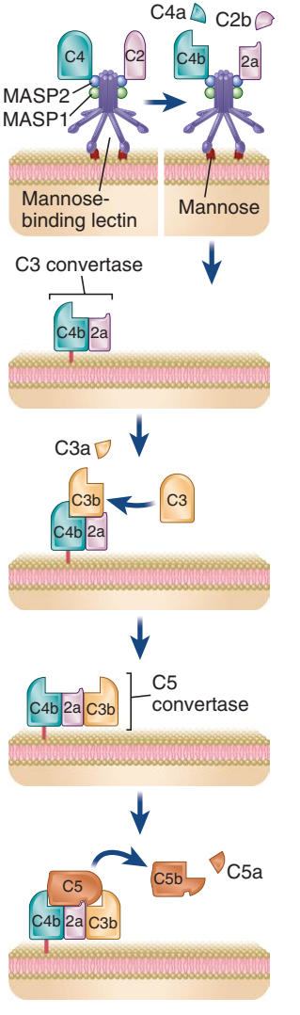
Lectin pathway

Slide 19
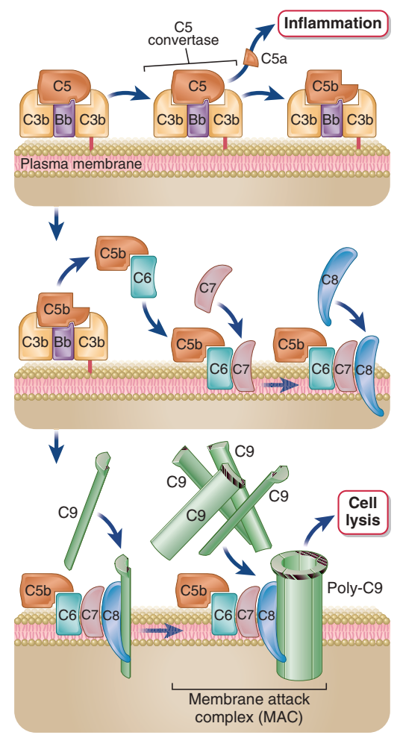
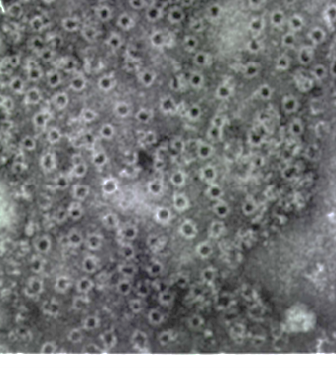
Mac formation

Slide 20
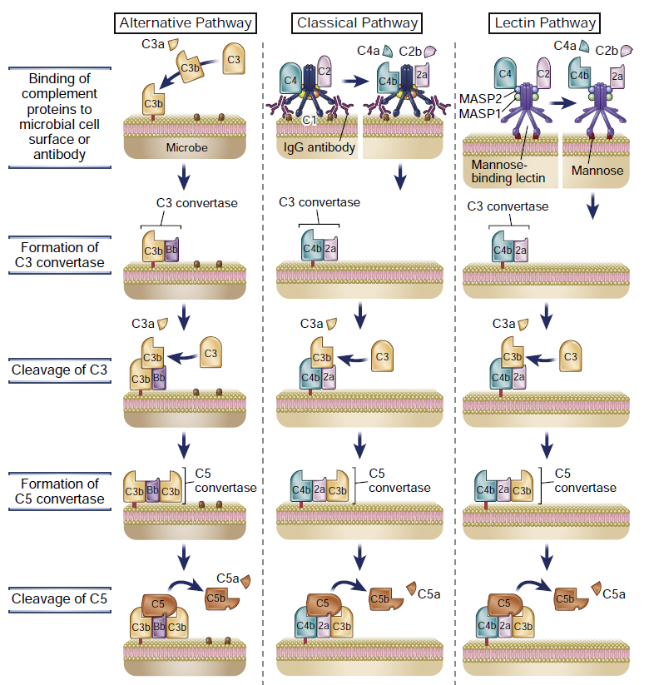

Slide 21
Mechanisms to Prevent Damage to Host Tissues:
Cell Membrane Proteins:
  Host cells express complement regulatory proteins to shield themselves from complement attack.
Inhibition of Anaphylatoxins:
  Regulatory proteins like C1 inhibitor reduce inflammation caused by anaphylatoxins (C3a, C5a).
Endothelial Barrier:
  Endothelial cells help maintain vascular integrity, preventing inappropriate complement activation in blood vessels.

Slide 22
Regulation of the classic and alternative pathway.
C1 Inhibitor (C1-INH): Regulates C1 activation.
C4 Binding Protein (C4BP): Displaces C4b, preventing further activation.
Factor I: Cleaves C4b and C3b into inactive fragments.
Decay Accelerating Factor (DAF): Inhibits C3 convertase formation.
Membrane Cofactor Protein (MCP): Promotes cleavage of C3b.
Factor H: Inhibits spontaneous activation of the alternative pathway by competing with Factor B and promoting cleavage of C3b.
Decay Accelerating Factor (DAF): Inhibits the formation of C3 convertase.
Factor I: Cleaves C3b and C4b into inactive fragments.
Membrane Cofactor Protein (MCP): Promotes the cleavage of C3b.
Protectin (CD59): Inhibits MAC formation on host cells.
S Protein (vitronectin): Prevents MAC insertion into cell membranes.

Slide 23
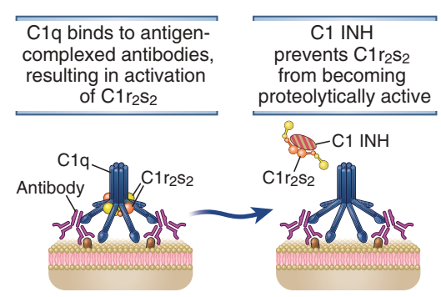
C1INH

Slide 24
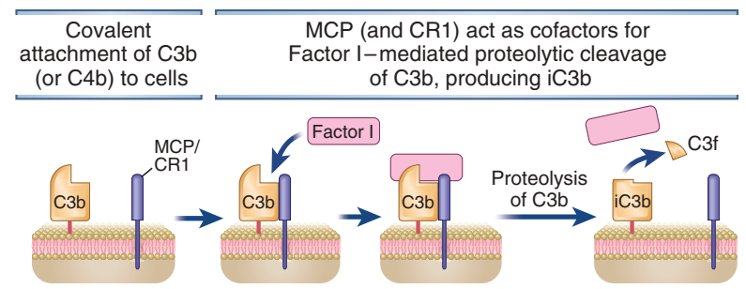

C3 inhibitors
60 second

Slide 25
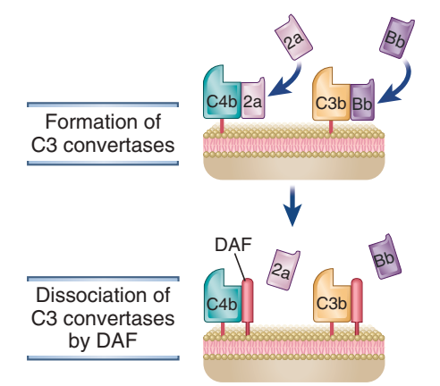
C3 Convertase inhibitor
60 second

Slide 26
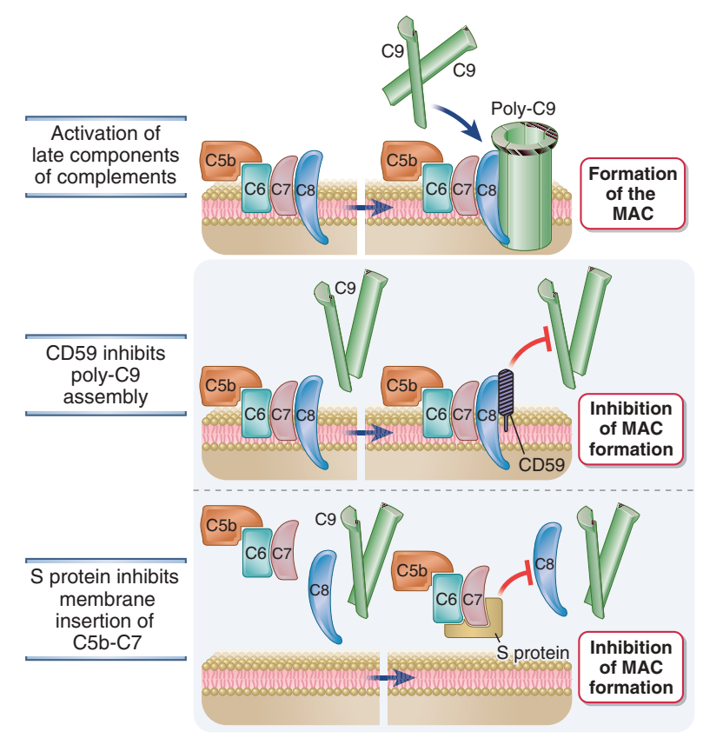
MAC formation inhibition
150 second

Slide 27
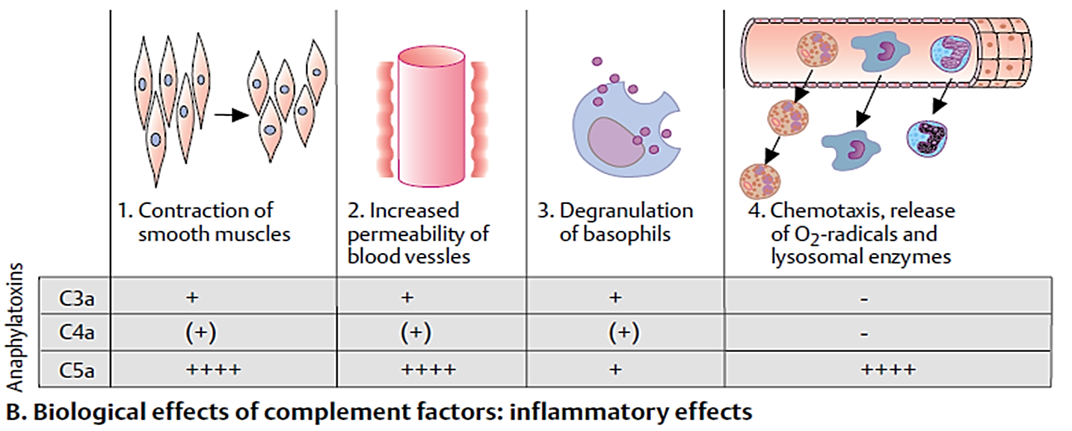
Anaphylatoxins

Slide 28

The Complement and diseases

Slide 29
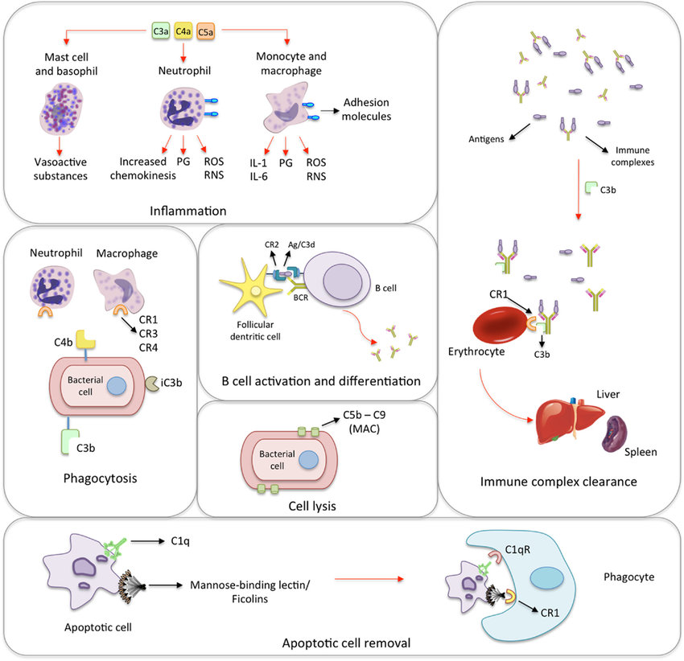

The Good

Slide 30
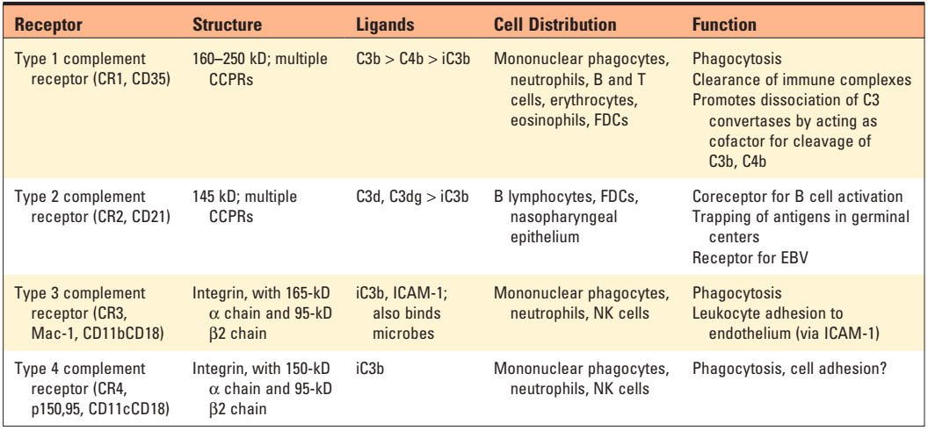
Receptors for Fragments of C3

Slide 31

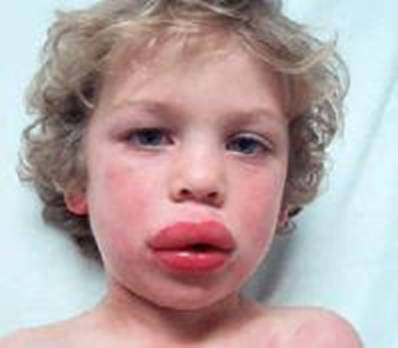
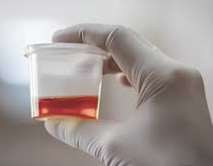
Diseases associated with complement dysfunction
The Bad
Complement Deficiency | Clinical Implications | Disease Associations | Therapeutic Approach
C1 Esterase Inhibitor Deficiency | Leads to uncontrolled activation of the classical pathway; results in angioedema. | Hereditary angioedema (HAE) | C1 inhibitor replacement therapy; androgens (e.g., danazol) to increase C1 inhibitor levels.
C3 Deficiency | Impaired opsonization; increased susceptibility to encapsulated bacteria. | Increased risk of severe bacterial infections. | Antibiotic prophylaxis; immunoglobulin replacement therapy.
C5 Deficiency | Defects in forming the membrane attack complex (MAC); increased susceptibility to Neisseria infections. | Increased risk of Neisseria meningitidis. | Antibiotic prophylaxis; vaccination against Neisseria species.
C6 Deficiency | Similar to C5 deficiency; impairments in MAC formation. | Increased risk of Neisseria infections. | Antibiotic prophylaxis; vaccination against Neisseria species.
C7 Deficiency | Impaired MAC formation; increased susceptibility to certain bacterial infections. | Increased risk of Neisseria infections. | Antibiotic prophylaxis; vaccination against Neisseria species.
C8 Deficiency | Defective MAC formation; increased susceptibility to Neisseria infections. | Increased risk of Neisseria infections. | Antibiotic prophylaxis; vaccination against Neisseria species.
C9 Deficiency | Impaired MAC formation; generally milder clinical presentation. | Increased risk of Neisseria infections. | Antibiotic prophylaxis; vaccination against Neisseria species.
Factor H Deficiency | Uncontrolled alternative pathway activation; increased risk of kidney disease. | Atypical hemolytic uremic syndrome (aHUS). | Plasma exchange; complement inhibitors (e.g., eculizumab).
Factor I Deficiency | Excessive activation of the alternative pathway; increased risk of severe bacterial infections and aHUS. | Increased risk of severe bacterial infections and aHUS. | Plasma replacement; complement inhibitors.
Decay-Accelerating Factor (DAF) Deficiency | Increased susceptibility to complement-mediated lysis of red blood cells. | Paroxysmal nocturnal hemoglobinuria (PNH). | Eculizumab (complement inhibitor); supportive care.
Hereditary Angioedema
Paroxysmal nocturnal hemoglobinuria (PNH)

Slide 32
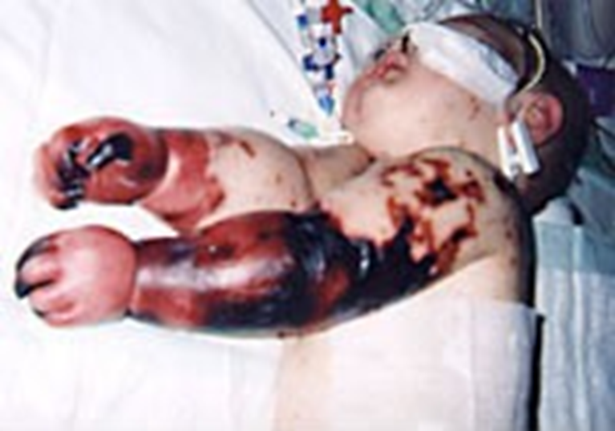
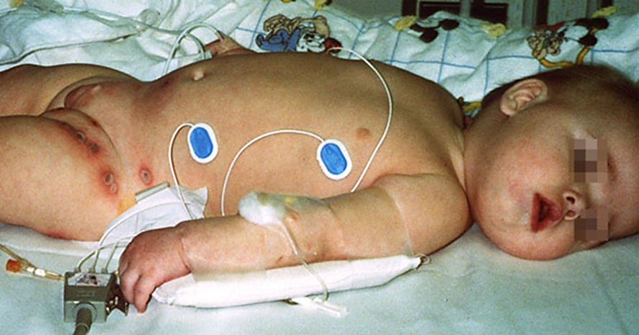
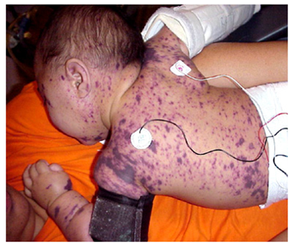
Neisseria infections

Slide 33

The Ugly
Autoimmune Disease | Clinical Implications | Key Complement Components Involved | Pathogenesis Association | Main Therapeutic Approach
Systemic Lupus Erythematosus (SLE) | Characterized by autoantibody production and immune complex deposition, leading to tissue damage. | C1, C2, C3, C4 | Complement activation promotes inflammation and tissue injury through immune complex deposition. | Immunosuppressants (e.g., corticosteroids, hydroxychloroquine); complement inhibitors (e.g., eculizumab).
Atypical Hemolytic Uremic Syndrome (aHUS) | Associated with endothelial dysfunction and thrombotic microangiopathy; can lead to renal failure. | Factor H, Factor I | Dysregulation leads to uncontrolled complement activation, causing endothelial damage and thrombus formation. | Plasma exchange; complement inhibitors (e.g., eculizumab).
Membranoproliferative Glomerulonephritis (MPGN) | Kidney damage associated with complement-mediated glomerular injury and inflammation. | C3, C4 | Complement activation leads to glomerular injury and enhances inflammatory responses in the kidney. | Immunosuppressive therapy; complement inhibitors.

Slide 34
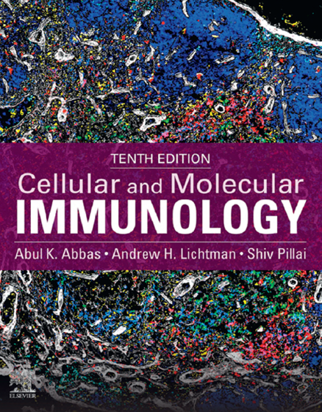
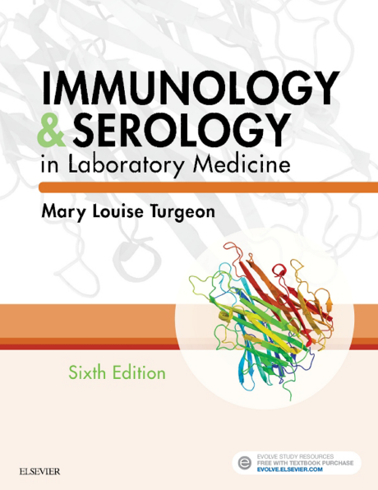
References

Slide 35





Shahid Beheshti University of Medical Sciences
Tehran, Iran
fyeganeh@gmail.com
09127200243
Immunology Dept. SBMU

