Slide 1

Major Histocompatibility Complex and other Antigen-Presenting Molecules
Farshid Yeganeh, PhD
Immunology Dept.
Shahid Beheshti University of Medical Sciences,

Slide 2
Learning Objectives
By the end of this session, students should be able to:
Define antigen-presenting molecules and their immunologic role.
Differentiate between MHC class I and class II molecules.
Explain the mechanism of antigen processing and presentation.
Recognize the pharmacological relevance of MHC in immune-mediated diseases and drug responses.

Slide 3
Major Antigen-Presenting Molecules
MHC Class I molecules — present endogenous peptides to CD8⁺ cytotoxic T cells.
MHC Class II molecules — present exogenous peptides to CD4⁺ helper T cells.
CD1 molecules — present lipid antigens to NKT cells.
MR1 molecules — present vitamin B–derived metabolites to MAIT cells.

Slide 4
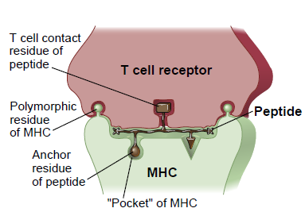
A model for T cell recognition of a peptide
Cellular and Molecular Immunology; ELSEVIER. Tenth edition

Slide 5
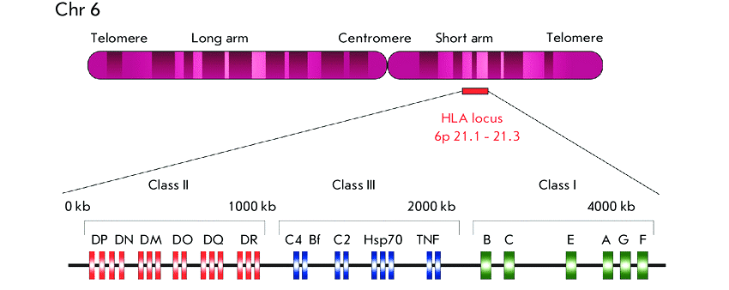
Map of the human major histocompatibility complex
Acta Naturae. 2019 Oct-Dec; 11(4): 4–12.

Slide 6
MHC or HLA
The HLA complex contains >240 genes of diverse functions.
The MHC gene family is divided into three subgroups or classes, named I, II, and III.
Class I
Major genes:
HLA-A
HLA-B
HLA-C
Minor genes:
HLA-E
HLA-F
HLA-G
Class II
Major MHC class II proteins:
HLA-DP
α-chain encoded by HLA-DPA1 locus
β-chain encoded by HLA-DPB1 locus
HLA-DQ
α-chain encoded by HLA-DQA1 locus
β-chain encoded by HLA-DQB1 locus.
HLA-DR
α-chain encoded by HLA-DRA locus
four β-chains (only 3 possible per person), encoded by HLA-DRB1, DRB3, DRB4, and DRB5 loci.
Minor MHC class II proteins
DM
DO

Slide 7
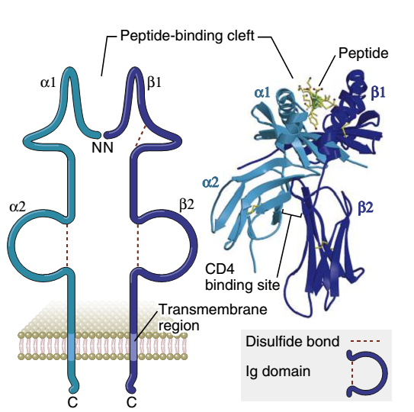
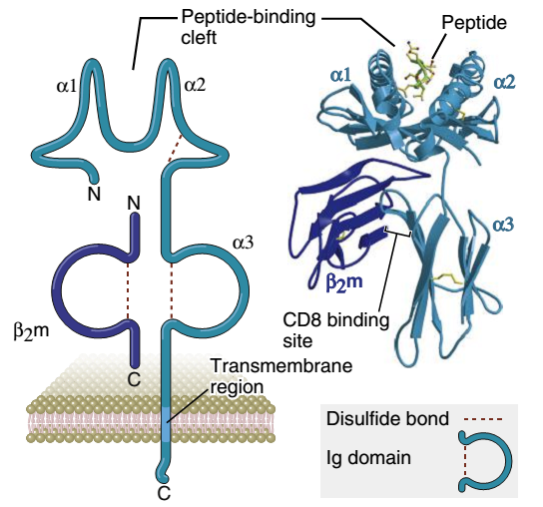
Structure of the MHC molecule
HLA antigens are glycoproteins and belong to the immunoglobulin superfamily.

Slide 8
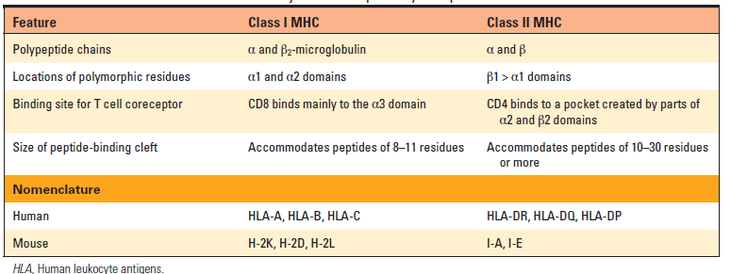
Properties and Functions of Major Histocompatibility complex
Cellular and Molecular Immunology; ELSEVIER. Tenth edition

Slide 9
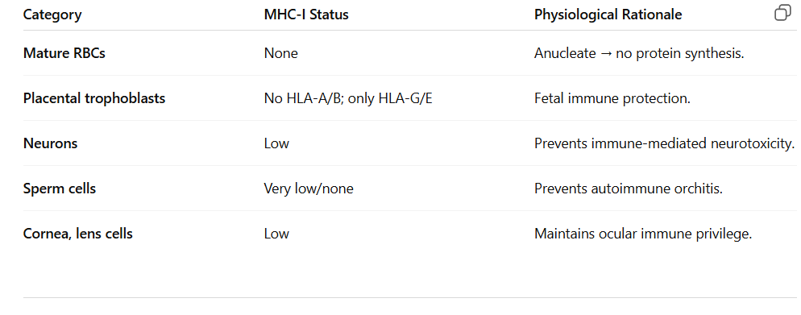
The Expression of MHC among Tissues
Immunobiology, 9th edition. Garland Science

Slide 10
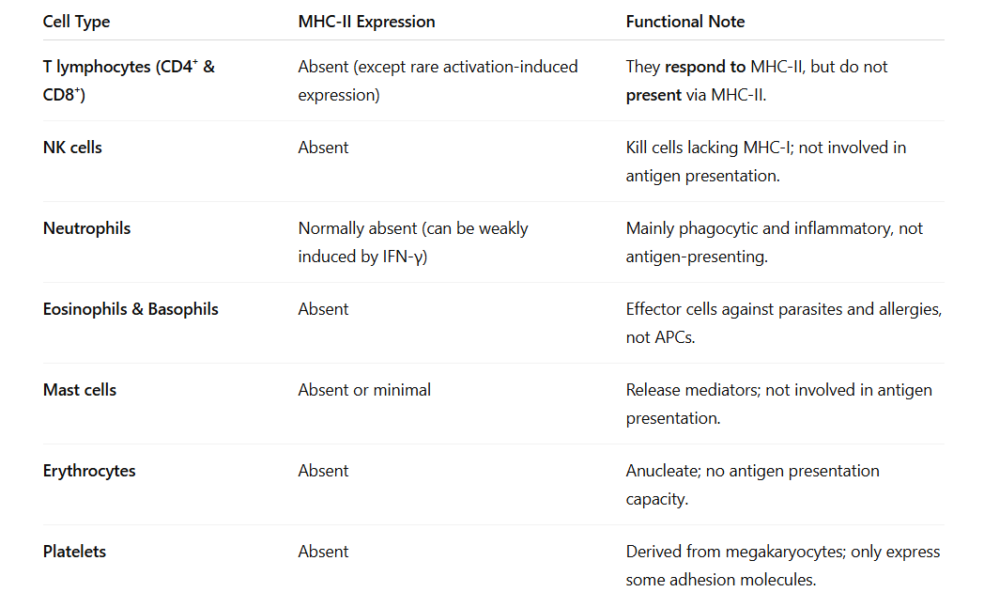
The Expression of MHC among Tissues

Slide 11
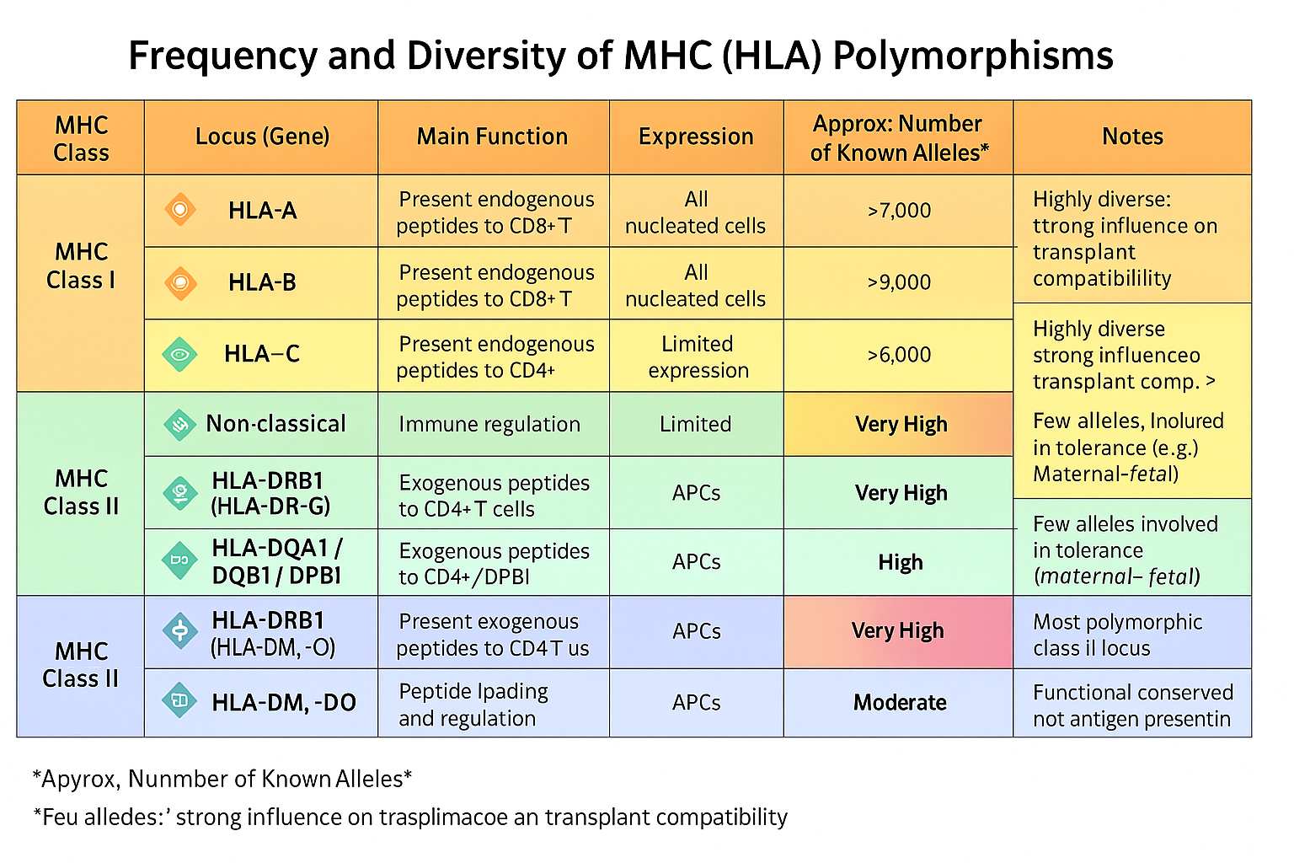

Slide 12
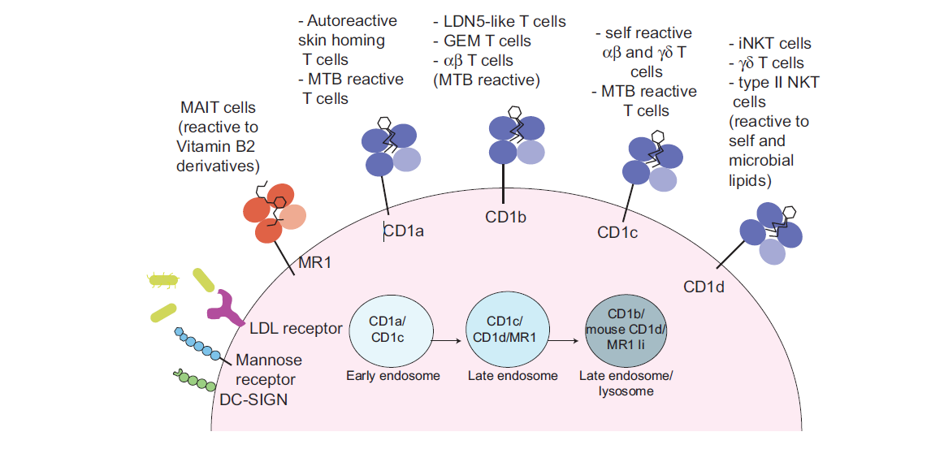
CD1 and MR1 Molecules
CD1: structurally MHC-I-like, but presents lipid/glycolipid antigens (e.g., from Mycobacterium tuberculosis).
MR1: presents riboflavin (vitamin B2) metabolites to MAIT cells.
Both bridge innate and adaptive immunity via unconventional T cells.
MAIT cells are unconventional T cells that recognize small metabolite antigens derived from the vitamin B2 (riboflavin) biosynthesis pathway of bacteria and fungi.

Slide 13

Take home message

Slide 14




دانشگاه علوم پزشکی و خدمات بهداشتی درمانی شهید بهشتی
Shahid Beheshti University of Medical Sciences
Tehran, Iran
fyeganeh@gmail.com
09127200243
Immunology Dept. SBMU

